Slide 1
OBBBA – Reporting Overtime and Overtime Differentials
Division of Finance – Department of Administration

Slide 2
Content Guide
Resources ..……………………………………………………………………….. 3
Background ..…………………………………………………………………….. 4
Who does this material apply to?.......................................... 5
What does this mean for you?............................................... 6
Understanding Pay Types and Overtime Eligibility……………… 9
Qualified vs. Non-Qualified Time………………………………………. 10
What determines if it’s qualified or non-qualified? ………….. 13
Claiming Overtime …………………………………………………………… 20
Claiming Holiday Premium Pay …………................................. 24

Slide 3
Resources
Employees and administrative staff are encouraged to review the following resources for detailed guidance on accurately reporting time on timesheets:
Personnel Rules
Review specific provisions related to timekeeping and compensation.
Alaska Administrative Manual (AAM)
Reference official procedures and standards for state operations.
Fair Labor Standards Act (FLSA)
Learn about federal labor regulations, including overtime eligibility.
Division of Finance – Payroll
Use additional resources and references available to State of Alaska employees.
Department of Law – Interpretative Memorandum
Use to clarify practice and procedures regarding pay.

Slide 4
Background
Beginning December 22, 2025, the State of Alaska will adopt revised timesheet procedures to align with the requirements of Public Law 119-21 (the One Big Beautiful Bill Act).
This federal law introduced a new tax deduction for eligible overtime earnings through 2028. To support accurate reporting, the State is implementing updated procedures for recording overtime and premium pay.

Slide 5
Who does this material apply to?
The content of this training applies to all overtime eligible (FLSA non-exempt) employees in the following categories
All employees who are eligible for overtime should review and understand the procedures outlined in this material to ensure time is accurately reported on their timesheet. As well as salaried (FLSA Non-exempt) employees who claim sea duty.
In addition, anyone who supervises, reviews, or approves timesheets for employees in the above categories are required to become familiar with and proficient in the processes described. Accurate timesheet reporting is essential to ensure compliance with updated payroll and tax procedures.

Slide 6
What does this mean for you?
To comply with updated tax regulations, all FLSA non-exempt (overtime eligible) employees must report applicable premium pay codes on their timesheets in a format that supports accurate processing by the Division of Finance.
These procedures do not apply to FLSA-exempt (salaried) employees.
It is essential that supervisors reviewing and certifying employee timesheets are fully informed of the updated procedures to guarantee compliance and accurate payroll processing.

Slide 7
What does this mean for you?
Employees should be aware that overtime earnings will continue to appear as taxed on their paystubs. This is expected and does not indicate an error.
Although certain premium pay types may qualify for a tax credit, this credit will not be reflected in regular payroll withholding. Instead, eligible employees will have the opportunity to claim the credit when filing their annual tax return, using information that will be provided on their W-2 form.

Slide 8
What does this mean for you?
Because eligibility for the credit depends on accurate reporting, it is essential that all applicable premium pay codes are correctly recorded on an employee’s timesheets.
Please note: The Division of Finance cannot provide individual tax advice. Employees are encouraged to consult a qualified tax professional for guidance specific to their personal tax situation.

Slide 9
Understanding Pay Types and Overtime Eligibility
Certain pay types are commonly used to help employees meet their standard workweek requirements but do not count toward the calculation of overtime eligibility. Please note that overtime rules may vary by bargaining unit, so employees should consult their applicable collective bargaining agreement for details specific to their situation.
Examples Of Pay Types That Do Not Count Toward Overtime Thresholds:
All leave types
Office Closures
Regular Holiday Pay (not worked)
Only hours spent physically working count toward an employee’s FLSA overtime threshold.

Slide 10
Qualified vs. Non-Qualified Time
This procedural change applies to a wide range of premium pay codes—not just overtime.
Any pay that compensates at 1.5x or more than an employee’s regular rate of pay, along with most associated premium pays, are required to differentiate between qualified and non-qualified time.
Reminder:
These updates apply only to employee’s deemed overtime eligible by FLSA standards. These changes to time reporting do not impact salaried (overtime ineligible) employees.

Slide 11
Qualified vs. Non-Qualified Time
Not all overtime or premium pay types earned are eligible for the tax credit opportunity. As a result, employees will be required to record overtime and other applicable premium pays on their timesheets using either qualified or non-qualified pay codes, depending on eligibility.
Qualified pay codes will end with the letter “Q”
Non-qualified pay codes will end with the letter “N”
For example:
Overtime may be recorded using Event Type 251Q (qualified) or 251N (non-qualified)
Swing Overtime may be recorded using Event Type 260Q (qualified) or 260N (non-qualified)
It is essential that all State of Alaska employees use the correct pay codes to ensure accurate reporting and compliance with the new procedures.

Slide 12
Qualified vs. Non-Qualified Time
Description | Old Event Code | New Event Code (Non-Qualified) | New Event Code (Qualified)
Overtime 1.5 | 251 | 251N | 251Q
Overtime Double | 252 | 252N | 252Q
Holiday Worked | 249 | 249N | 249Q
Recall Within 4 Hours | 243 | 243N | 243Q
Recall with Minimum Guarantee | 244 | 244N | 244Q
Swing Overtime 1.5 | 260 | 260N | 260Q
Swing Double | 262 | 262N | 262Q
Grave Overtime 1.5 | 270 | 270N | 270Q
Grave Double | 272 | 272N | 272Q
Weekend Premium | 235 | 235N | 235Q
Overtime 1.5 | 251C | 251CN | 251CQ
Holiday Worked | 249C | 249CN | 249CQ
*Changes were also made to Sea Duty and EFF time reporting – see specific section for additional details*

Slide 13
What determines if it’s qualified or non-qualified?
Chronologically speaking, it is important to understand that qualified pay types are not limited to hours worked after reaching 40 hours in a workweek.
The day in the week when overtime, holiday premium pay, or recall/call back occur does not determine qualification. What matters is that the employee physically works more than 40 hours within the designated workweek.
The primary pay codes that should be used to reach an employee’s 40-hour threshold are event codes that represent physical hours worked at a regular rate of pay.
Event Code 100 (Regular Hours) and Event Code 250 (Straight Pay)
If event codes 100 and 250 do not equal 40 hours within the workweek, then time worked at a rate of 1.5x or more begin to be included, starting with time worked earliest in the week (from left to right).

Slide 14
What determines if it’s qualified or non-qualified?
Employees have the potential to record hours at a pay rate of 1.5x or more on a day that falls before their required workweek hours are reached.
Examples: Overtime (if accrued daily), Holiday Premium Pay, Recall/Call Back
Hours paid at a rate of 1.5x or higher on a day before the workweek requirement is met may still be considered qualified if:
The employee’s regular hours alone total 40 for the week, or
The regular hours combined with straight pay reach 40
If regular hours and straight pay (if present) do not reach 40, then hours worked at a pay rate of 1.5x or more will begin to be included in reaching the 40 hours needed for qualified time.
Hours at 1.5x or more that are included in reaching the 40-hour threshold are considered non-qualified time.
When non-qualified time is used to reach 40, the earliest hours in the week at a pay rate of 1.5x or more will have the non-qualified pay codes applied.
Hours will continue to be considered non-qualified until they reach 40, at which point all remaining pay at a rate of 1.5x or more in the week will begin to be considered qualified.

Slide 15
What determines if it’s qualified or non-qualified?
Pro Tip!
To determine how many hours at a pay rate of 1.5x or more within a week should be considered qualified and verify accurate reporting, proceed with the following steps.
Step 1: Calculate hours physically worked within the week.
Add up all hours physically worked during the workweek.
Exclude any leave or holiday hours – only actual time worked counts.
Step 2: Compare Against the 40-Hour FLSA Threshold
If total hours physically worked exceed 40, the number of hours above 40 should be how many hours are recorded as qualified time within that week.
If pay at a rate of 1.5x or higher are included in reaching (but not exceeding) 40 hours, those hours are considered non-qualified.
If total physical hours worked are 40 or less, all pay at a rate of 1.5x or more is considered non-qualified.

Slide 16
What determines if it’s qualified or non-qualified?
Example:
An employee physically worked 49.75 hours in a workweek.
49.75 – 40 = 9.75
49.75 (hours physically worked in a week) minus 40 (FLSA qualified time threshold) = 9.75 hours of qualified time to be recorded on timesheet for that week.
Considering the FLSA threshold for qualified time is 40 hours, and a total of 49.75 hours in that week were worked, 9.75 hours in the workweek must be considered qualified – whether that be overtime, holiday premium pay, recall/call back, or double time.

Slide 17
What determines if it’s qualified or non-qualified?
Pro Tip x2!
If an employee has not reached the 40-hour FLSA overtime threshold with worked hours that are paid at their regular rate, follow these steps to calculate the number of non-qualified hours that must be recorded before reporting any qualified overtime.
Step 1: Calculate hours physically worked within the week that pay at a normal rate of pay.
Add up Regular Pay hours (Event Code 100) and if present, Straight Pay hours (Event Code 250)
Be sure to exclude any leave or holiday hours, or hours that are required to be paid at a rate of 1.5x or more.
Step 2: Compare Against the 40-Hour FLSA Threshold
Subtract the number of hours calculated in Step 1 from 40. The remaining hours represent the amount of time paid at 1.5x or higher that must be reported as non-qualified before any qualified time can be recorded.

Slide 18
What determines if it’s qualified or non-qualified?
Example:
Within a workweek, an employee has 34 hours physically worked that pay at their normal rate of pay.
40 – 34 = 6
40 (FLSA qualified time threshold) minus 34 (hours worked and paid at a normal pay rate) = 6 hours of non-qualified time needed before being eligible to claim qualified time.
In this example, if the employee has hours during the week that must be paid at 1.5x or higher, the first 6 of those hours must be recorded as non-qualified. After recording these 6 non-qualified hours, any additional hours at 1.5x or higher will be considered qualified.

Slide 19
What does all of this look like on a timesheet?
The following slides provide visual examples and additional guidance on properly recording overtime and other premium pay types on a timesheet.
Disclaimer: These examples are intended as a helpful guide only. They do not cover every possible time reporting situation.

Slide 20
Claiming Overtime:
EX, PX

Slide 21
Claiming Overtime: EX, PX Event Code 251Q
This section provides visual examples of how to accurately record overtime on a timesheet. It is specifically designed for employees in Partially Exempt or Exempt service categories.
These employees are required to meet a 37.5-hour workweek but are only eligible for overtime after reaching 40 hours of physically worked time. As a result, they will not need to use non-qualifying overtime, since their overtime is only earned once the full 40-hour threshold is met.
Disclaimer: These examples are intended as a helpful guide only. They do not cover every possible time reporting situation.

Slide 22
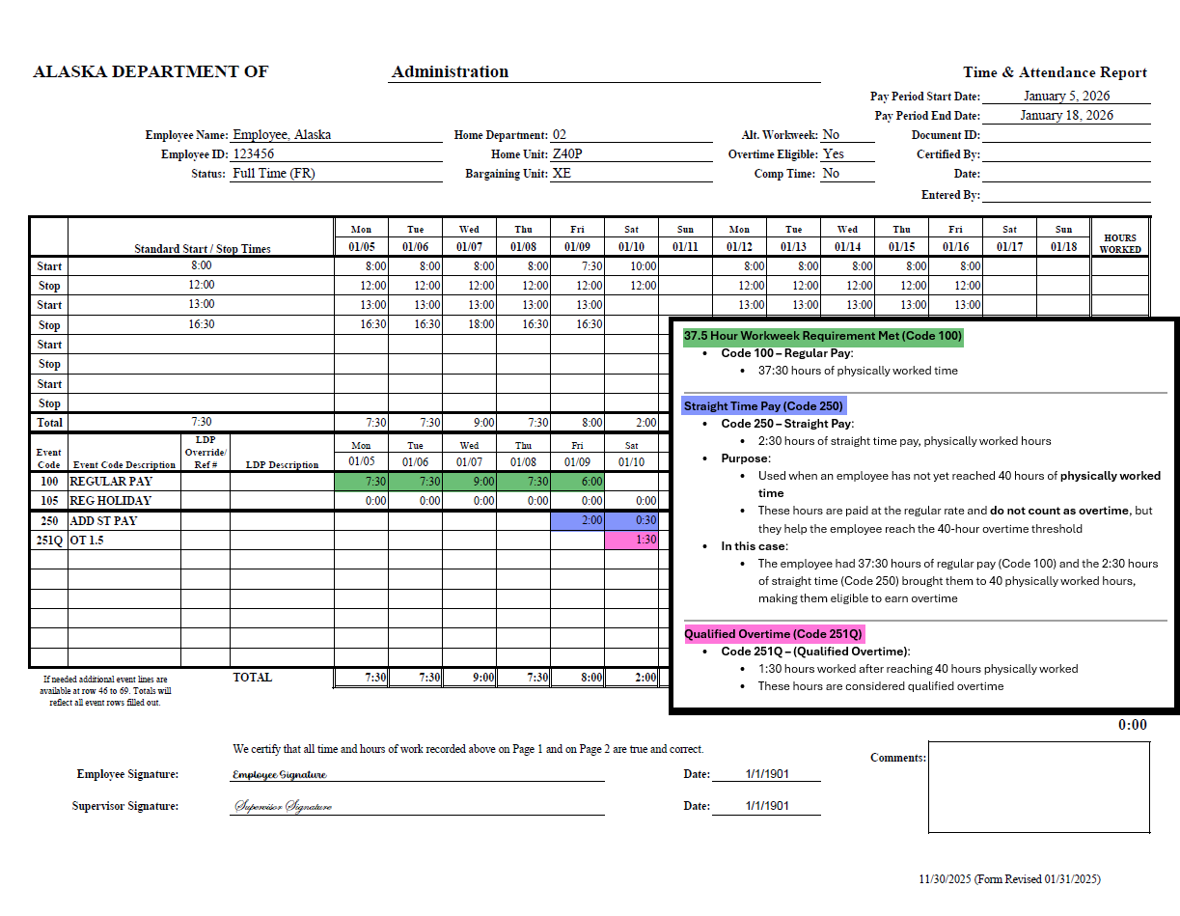
Claiming Overtime: EX, PX
Include guidance surrounding 250 needed

Slide 23
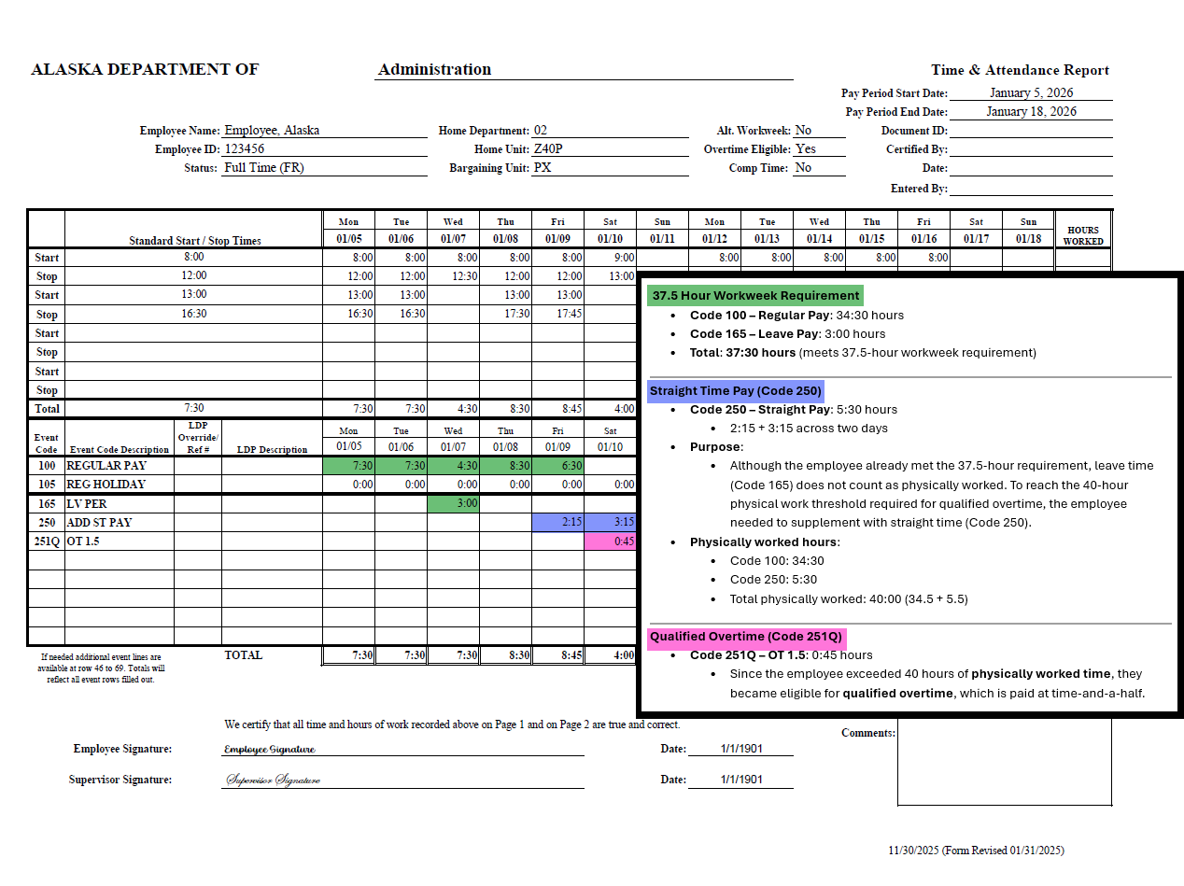
Claiming Overtime: EX, PX
251Q

Slide 24
Claiming Holiday Premium Pay:
PX, EX

Slide 25
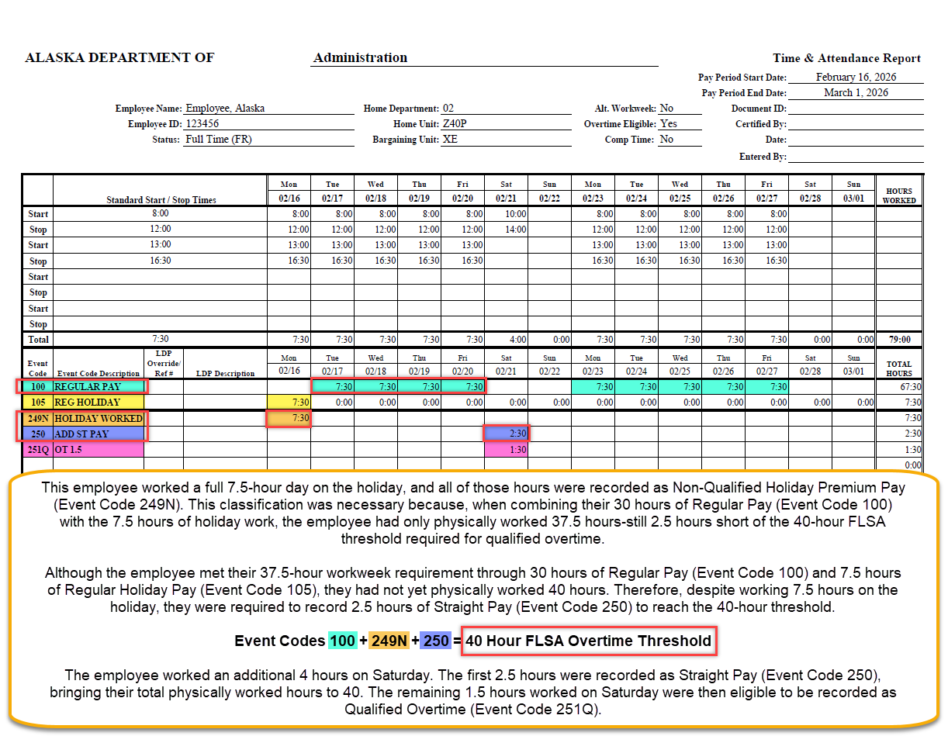
Claiming Holiday Premium Pay: PX, EX
249N – don’t keep in here, move to dept specific - done

Slide 26
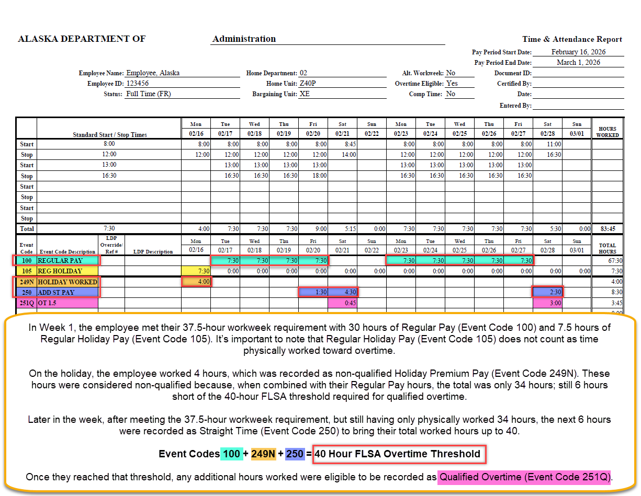
Claiming Holiday Premium Pay: PX, EX
249Q – don’t keep in here, move to dept specific - done

Slide 27
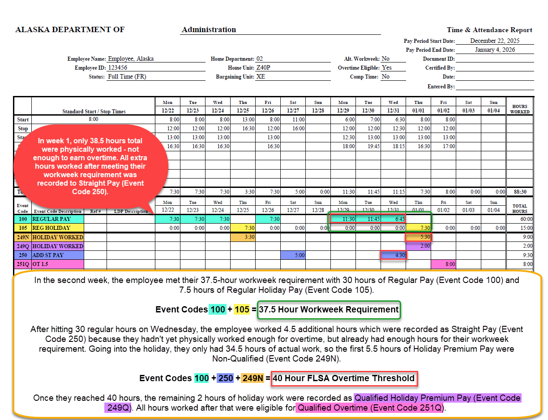
Claiming Holiday Premium Pay: PX, EX
249 mix– don’t keep in here, move to dept specific - done

Slide 28
Questions? Please contact _________

