Slide 1
OBBBA –Reporting Overtime and Overtime Differentials
Division of Finance – Department of Administration

Slide 2
Content Guide
Background .…….…………………………………………………………….... 3
Who does this material apply to?.......................................... 4
What does this mean for you?............................................... 5
Resources …………………………………………………………………..…….. 8
Understanding Pay Types and Overtime Eligibility……………… 9
Qualified vs. Non-Qualified Time………………………………………. 12
What determines if it’s qualified or non-qualified? ………….. 13
Determining the Work Period ..………………………………………….15
Claiming Overtime – ACOA ………………………………………………..19
Claiming Overtime – PSEA Troopers …………………………………..46

Slide 3
Background
Beginning December 22, 2025 for PSEA employees and December 18, 2025 for ACOA employees, the State of Alaska will adopt revised timesheet procedures to align with the requirements of Public Law 119-21 (the One Big Beautiful Bill Act).
This federal law introduced a new tax deduction for eligible overtime earnings through 2028. To support accurate reporting, the State is implementing updated procedures for recording overtime and premium pay.

Slide 4
Who does this material apply to?
The content of this training applies to all overtime eligible employees in the following categories:
Exempt or Partially Exempt Service
Exempt Emergency Fire Fighters (EFF)
Collective Bargaining Units including GGU, SU, LTC, CEA, ACOA and PSEA
All employees in these groups who are eligible for overtime should review and understand the procedures outlined in this material to ensure time is accurately reported on their timesheet.
In addition, anyone who supervises, reviews, or approves timesheets for employees in the above categories are required to become familiar with and proficient in the processes described. Accurate timesheet reporting is essential to ensure compliance with updated payroll and tax procedures.

Slide 5
What does this mean for you?
To comply with updated tax regulations, all FLSA non-exempt (overtime eligible) employees must report applicable premium pay codes on their timesheets in a format that supports accurate processing by the Division of Finance.
These procedures do not apply to FLSA-exempt (salaried) employees, even if they have an active Letter of Agreement authorizing compensation at 1.5 times their regular rate of pay.
It is essential that supervisors reviewing and certifying employee timesheets are fully informed of the updated procedures to guarantee compliance and accurate payroll processing.

Slide 6
What can you expect?
Employees should be aware that overtime earnings will continue to appear as taxed on their paystubs. This is expected and does not indicate an error.
Although certain premium pay types may qualify for a tax credit, this credit will not be reflected in regular payroll withholding. Instead, eligible employees will have the opportunity to claim the credit when filing their annual tax return, using information that will be provided on their W-2 form.

Slide 7
What can you expect?
Because eligibility for the credit depends on accurate reporting, it is essential that all applicable premium pay codes are correctly recorded on an employee’s timesheets.
Please note: The Division of Finance cannot provide individual tax advice. Employees are encouraged to consult a qualified tax professional for guidance specific to their personal tax situation.

Slide 8
Resources
Employees and administrative staff are encouraged to review the following resources for detailed guidance on accurately reporting time on timesheets:
Collective Bargaining Agreements
Review specific provisions related to timekeeping and compensation.
Personnel Rules
Review specific provisions related to timekeeping and compensation.
Alaska Administrative Manual (AAM)
Reference official procedures and standards for state operations.
Fair Labor Standards Act (FLSA)
Learn about federal labor regulations, including overtime eligibility.
Division of Finance – Payroll
Use additional resources and references available to State of Alaska employees.
Department of Law – Interpretative Memorandum
Use to clarify practice and procedures regarding pay.

Slide 9
Understanding Pay Types and Overtime Eligibility
Certain pay types are commonly used to help employees meet their standard workweek requirements but do not count toward the calculation of overtime eligibility. Please note that overtime rules may vary by bargaining unit, so employees should consult their applicable collective bargaining agreement for details specific to their situation.
Pay Types That Do Not Count Toward Overtime Thresholds:
All leave types
Office Closures
Regular Holiday Pay (when not worked)
Only hours spent physically working count toward an employee’s FLSA overtime threshold.

Slide 10
Which premium pays are included?
This procedural change applies to a wide range of premium pay codes—not just overtime.
Any Event Type (pay code) that compensates at 1.5 times an employee’s regular rate of pay, along with most associated premium pays, is included in this update. Examples include, but are not limited to:
Overtime
Holiday Premium pay
Double Time
Overtime shift differentials (e.g., Swing OT, Grave OT)
Recall pay
SERT pay
PILOT pay
Sea Duty
Academy Overtime
Reminder:
These updates apply only to employee’s deemed overtime eligible by FLSA standards. These changes to time reporting do not impact salaried (overtime ineligible) employees that may have a Letter of Agreement (LOA) allowing them to earn compensation at 1.5x their regular pay rate.

Slide 11
Which premium pays does this impact?
Description | Old Event Code | New Event Code (Non-Qualified) | New Event Code (Qualified)
Overtime 1.5 | 251 | 251N | 251Q
Overtime Double | 252 | 252N | 252Q
Holiday Worked | 249 | 249N | 249Q
Swing Overtime 1.5 | 260 | 260N | 260Q
Swing Double | 262 | 262N | 262Q
Grave Overtime 1.5 | 270 | 270N | 270Q
Grave Double | 272 | 272N | 272Q
Recall Within 4 Hours | 243 | 243N | 243Q
Recall with Minimum Guarantee | 244 | 244N | 244Q
SERT Premium Pay Overtime 1.5 | 234 | 234N | 234Q
PILOT Premium Pay Overtime 1.5 | 232 | 232N | 232Q
SERT Premium Pay Double | 23B | 23BN | 23BQ
PILOT Premium Pay Double | 23C | 23CN | 23CQ
Academy Overtime | 299 | 299N | 299Q
*Changes are also being made to Sea Duty reporting and are detailed on a later slide
**This list is not all inclusive of impacted codes

Slide 12
Qualified vs. non-qualified overtime
Not all overtime or premium pay types earned are eligible for the tax credit opportunity. As a result, employees will be required to record overtime and other applicable premium pays on their timesheets using either qualified or non-qualified pay codes, depending on eligibility.
Qualified pay codes will end with the letter “Q”
Non-qualified pay codes will end with the letter “N”
For example:
Overtime may be recorded using Event Type 251Q (qualified) or 251N (non-qualified)
Swing Overtime may be recorded using Event Type 260Q (qualified) or 260N (non-qualified)
It is essential that employees and supervisors use the correct pay code to ensure accurate reporting and compliance with the new procedures.

Slide 13
What determines if it’s qualified or non-qualified?
Chronologically speaking, it is important to understand that qualified pay types are not limited to hours worked after reaching the FLSA qualifying overtime threshold within a work period.
The day in the week when overtime, holiday premium pay, or recall/call back occur does not determine qualification. What matters is that the employee physically works more than the FLSA qualifying overtime threshold within the designated work period.
The primary pay codes that should be used to reach an employee’s FLSA qualifying overtime threshold are event codes that represent physical hours worked at a regular rate of pay.
Event Code 100 (Regular Hours) and Event Code 250 (Straight Pay)
If event codes 100 and 250 do not equal 40 hours within the workweek, then time worked at a rate of 1.5x or more begin to be included, starting with time worked earliest in the week (from left to right).

Slide 14
What determines if it’s qualified or non-qualified?
Employees have the potential to record hours at a pay rate of 1.5x or more on a day that falls before their required workweek hours are reached.
Examples: Overtime (if accrued daily), Holiday Premium Pay, Recall/Call Back
Hours paid at a rate of 1.5x or higher on a day before the workweek requirement is met may still be considered qualified if:
The employee’s regular hours alone total the specified FLSA threshold for the work period, or
The regular hours combined with straight pay reach the FLSA threshold for the work period
If regular hours and straight pay (if present) do not reach the qualifying FLSA threshold, then hours worked at a pay rate of 1.5x or more will begin to be included in reaching the hours needed for qualified time.
Hours at 1.5x or more that are included in reaching the FLSA threshold are considered non-qualified time.
When non-qualified time is used to reach the threshold, the earliest hours in the week at a pay rate of 1.5x or more will have the non-qualified pay codes applied.
Hours will continue to be considered non-qualified until they reach the FLSA threshold, at which point all remaining pay at a rate of 1.5x or more in the week will begin to be considered qualified.

Slide 15
Determining the Work Period
For law enforcement employees under FLSA Section 7(k), overtime is based on a fixed “work period” of 7 to 28 consecutive days set by the employer, rather than the standard 40‑hour week. The work period includes the single rotation of both on and off days.
The overtime threshold is proportional to 171 hours in a 28‑day period, meaning officers earn qualifying overtime after 43 hours for a 7-day work period, after 86 hours in a 14-day work period, or after 171 hours in a 28-day work period.
The work period covers the entire cycle of workdays and off days
To identify your work period, look at how your department structures its recurring schedule of on and off days. For example:
A 7 day/1-week cycle often follows the pattern of 5 days on/2 days off or 4 days on/3 days off.
A 14 day/2-week cycle often follows a pattern of 1 week on/1 week off.
A 28 day/4-week cycle often follows a pattern of 2 weeks on/2 weeks off.
The duration of the work period for different schedules is typically defined in Alternate Work Week agreements or the bargaining unit contract.

Slide 16
What determines if it’s qualified or non-qualified?
For overtime and other premium pay types to be considered qualified, an employee must physically work the required number of hours within their designated work period. In which case overtime and applicable premium pay types must be recorded using qualified pay codes.
For ACOA and PSEA, the qualifying threshold differs from the overtime threshold established in the bargaining unit contracts. As a result, employees might first earn non-qualifying overtime hours before reaching the qualifying overtime threshold.
If an employee does not physically work the required number of hours within their designated work period due to leave, holidays, or a shorter workweek requirement, any overtime or applicable premium pay earned during that period must be recorded using non-qualified pay codes.
Accurate recording of qualified versus non-qualified time is essential to ensure compliance with payroll procedures and proper tax reporting.

Slide 17
Qualified vs. non-qualified overtime
It is important to understand that qualified pay types are not limited only to hours worked after the date of reaching the work period requirement. The timing of when overtime or premium pay occurs does not determine qualification.
What matters is that the employee physically works the required number of hours during their designated work period.
This is an important consideration for employees who are considered daily overtime, receive recall premium pay early on in their workweek, or have an early week holiday. These hours may still be considered qualified, provided the employee physically works at least the required number of hours by the end of their work period.

Slide 18
What does all of this look like on a timesheet?
The following slides provide visual examples and additional guidance on properly recording overtime and other premium pay types on a timesheet.
Please pay close attention to any bargaining unit-specific notes or disclaimers, as procedures may vary depending on employee group.

Slide 19
Claiming Overtime: ACOA
Notes:
Presentation of the final design as it could be used in production of materials for communication. First design element to be aware of is the formatting of the powerpoint theme (using the new logo).

Slide 20
Claiming Overtime: ACOA
This section includes visual examples of how to correctly record nonqualifying and qualifying overtime on a timesheet. It is specifically intended for ACOA bargaining unit members.
The ACOA contract specifies 2 different schedules; 42-Hour and 84-Hour
42-Hour schedule
5 days on/2 days off
1-week work period (Thursday through Wednesday)
Threshold for qualifying overtime is 43 hours in 1 week
84-Hour schedule
1 week on/1 week off
2-week work period beginning on the first day of the pay period.
Threshold for qualifying overtime is 86 hours in 2 weeks
Please note: The following examples are intended as a helpful guide only. They do not cover every possible time-reporting situation.

Slide 21
Law Enforcement FLSA Threshold per Work Period Length
The chart below outlines the FLSA qualifying overtime thresholds based on the length of the work period.
Work Period | Law Enforcement FLSA Threshold
28 days | 171 hours
21 days | 128 hours
14 days | 86 hours
7 days | 43 hours

Slide 22
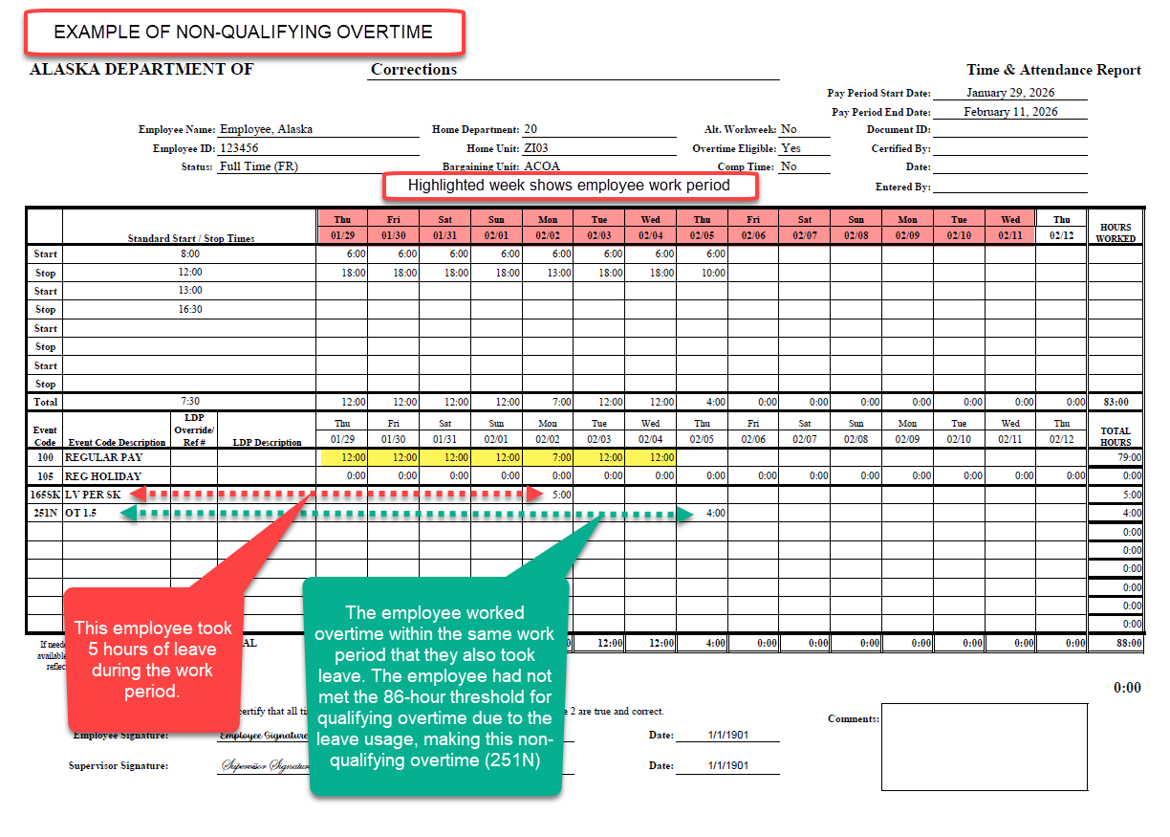

Slide 23
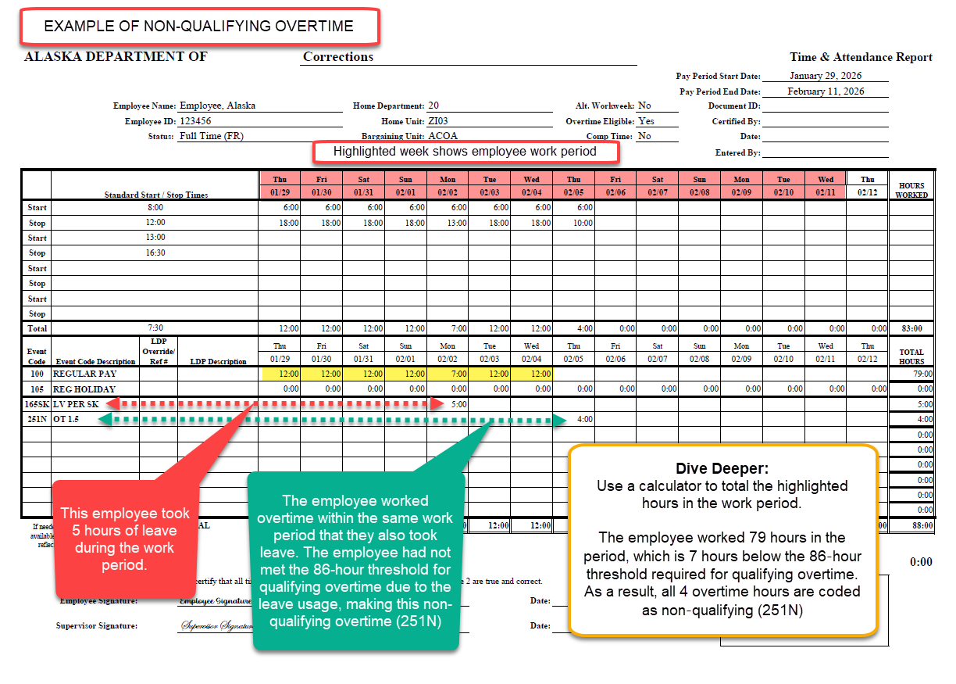

Slide 24
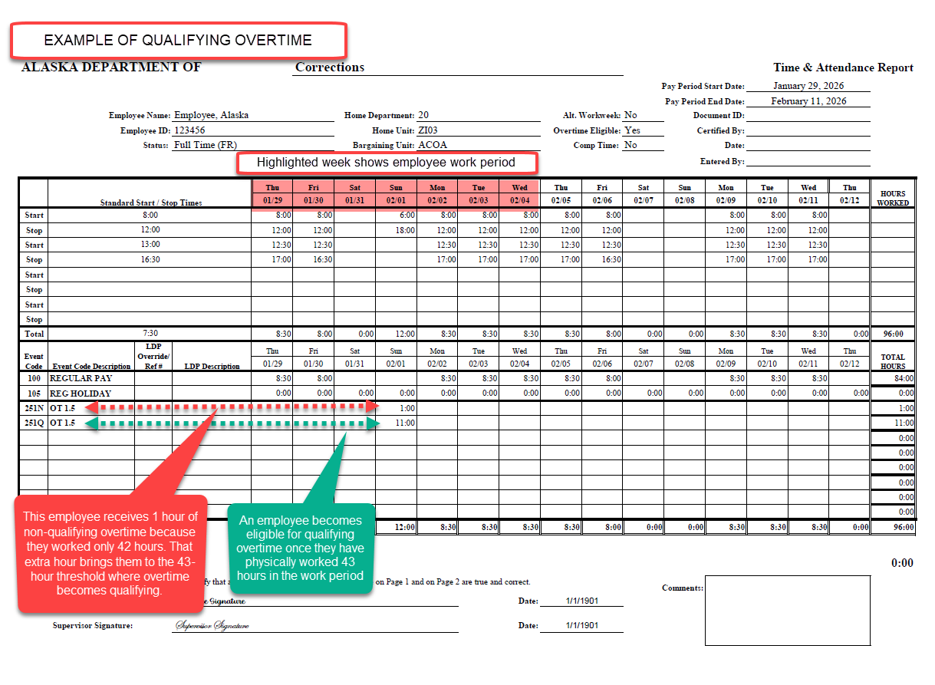

Slide 25
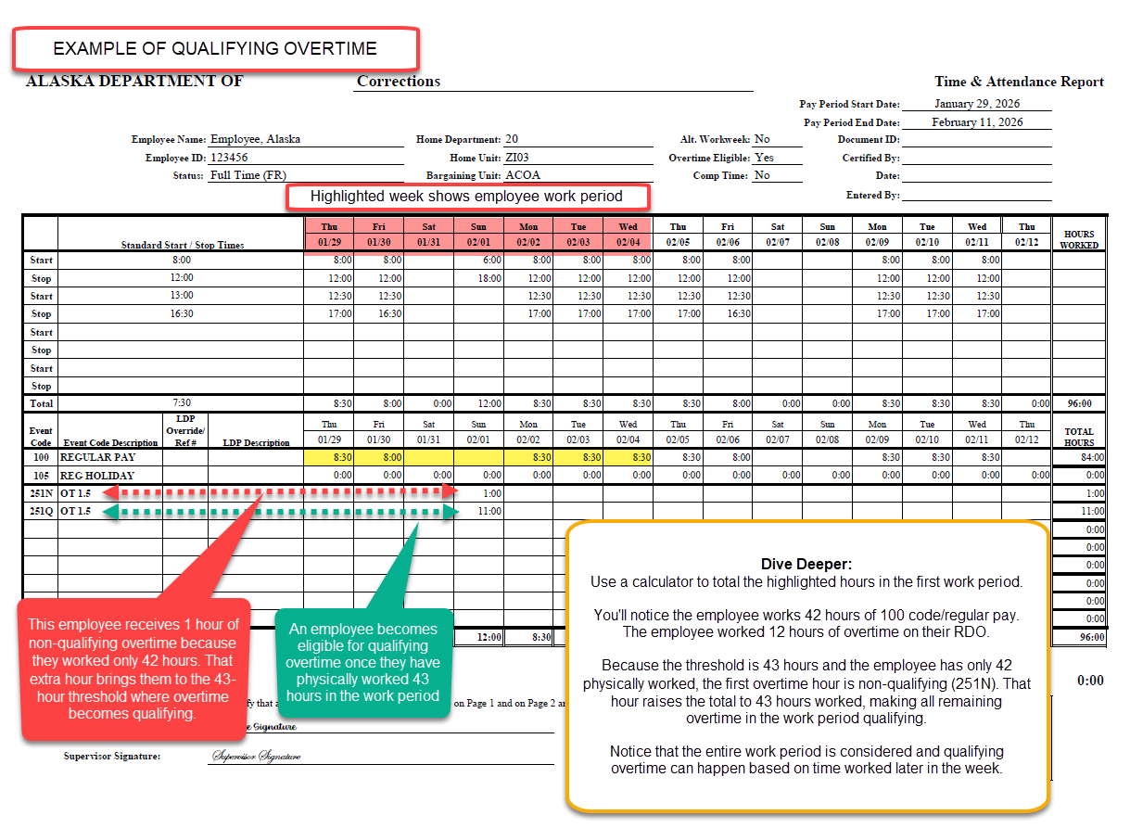

Slide 26
What determines if it’s qualified or non-qualified?
Pro Tip!
To determine how many hours at a pay rate of 1.5x or more within a week should be considered qualified and verify accurate reporting, proceed with the following steps.
Step 1: Calculate hours physically worked within the work period.
Add up all hours physically worked during the workweek.
Exclude any leave or holiday hours – only actual time worked counts.
Step 2: Compare Against the FLSA threshold for the work period length
If total hours physically worked exceed the threshold, the number of hours above the threshold should be how many hours are recorded as qualified time within that work period.
If pay at a rate of 1.5x or higher are included in reaching (but not exceeding) 40 hours, those hours are considered non-qualified.
If total physical hours worked are less than the FLSA threshold, all pay at a rate of 1.5x or more is considered non-qualified.

Slide 27
What determines if it’s qualified or non-qualified?
Example:
An employee physically worked 54:00 hours in a work period and has a FLSA requirement of 43:00 hours.
54:00 – 43:00 = 11:00
54:00 (hours physically worked in a work period) minus 43:00 (FLSA qualified time threshold) = 11:00 hours of qualified time to be recorded on timesheet for that week.
Considering the FLSA threshold for qualified time is 43:00 hours, and a total of 54:00 hours in that work period were worked, 11:00 hours in the work period must be considered qualified – whether that be overtime, holiday premium pay, recall/call back, or double time.

Slide 28
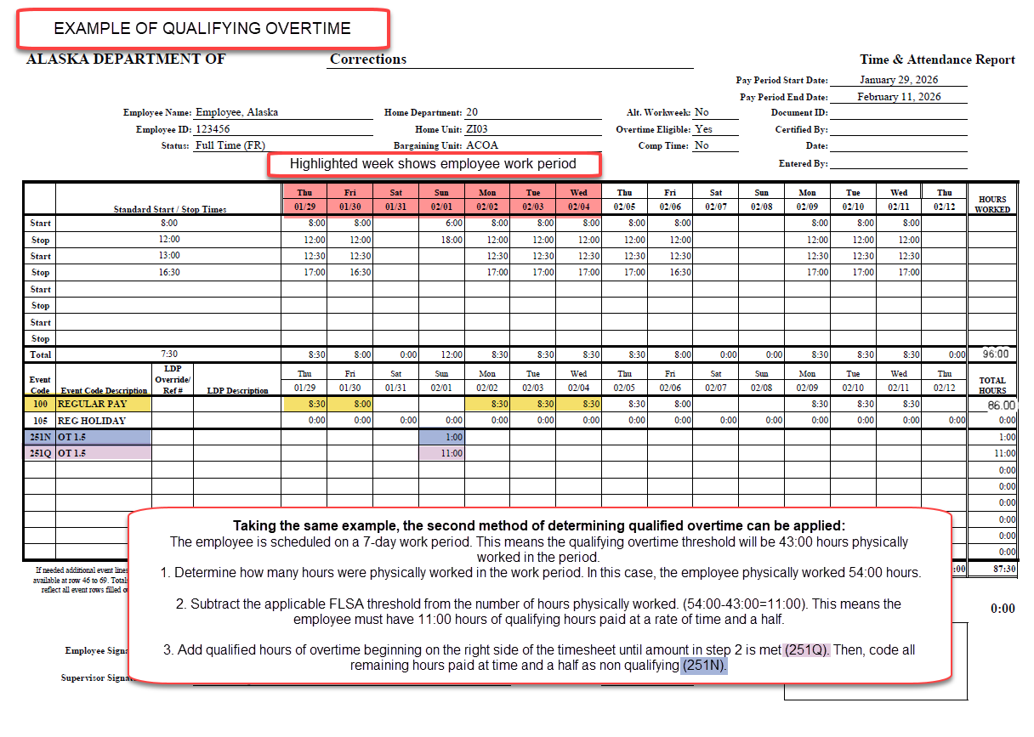

Slide 29
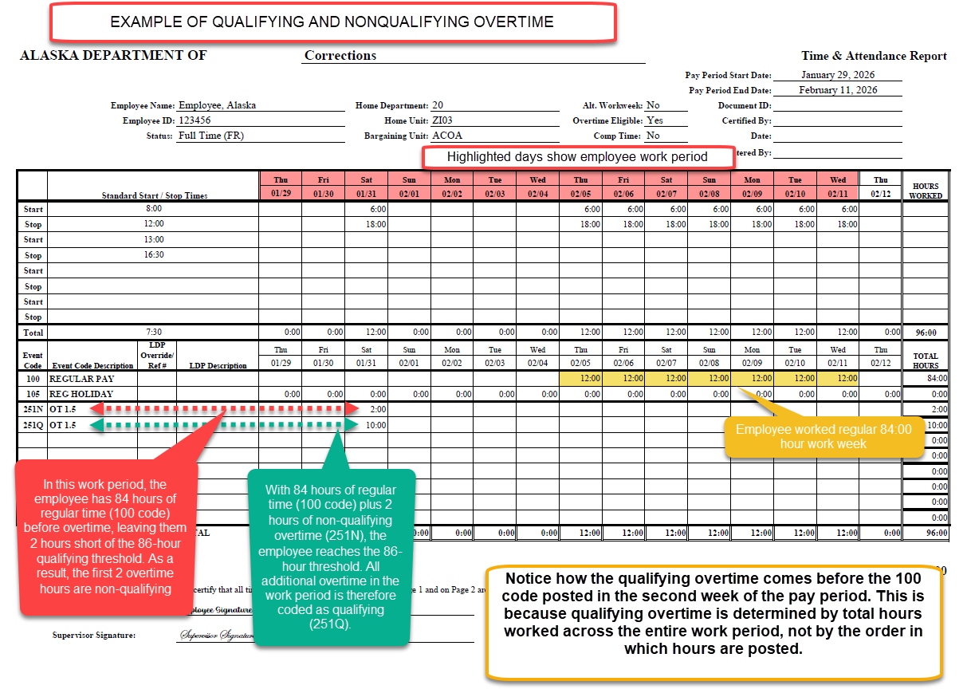

Slide 30
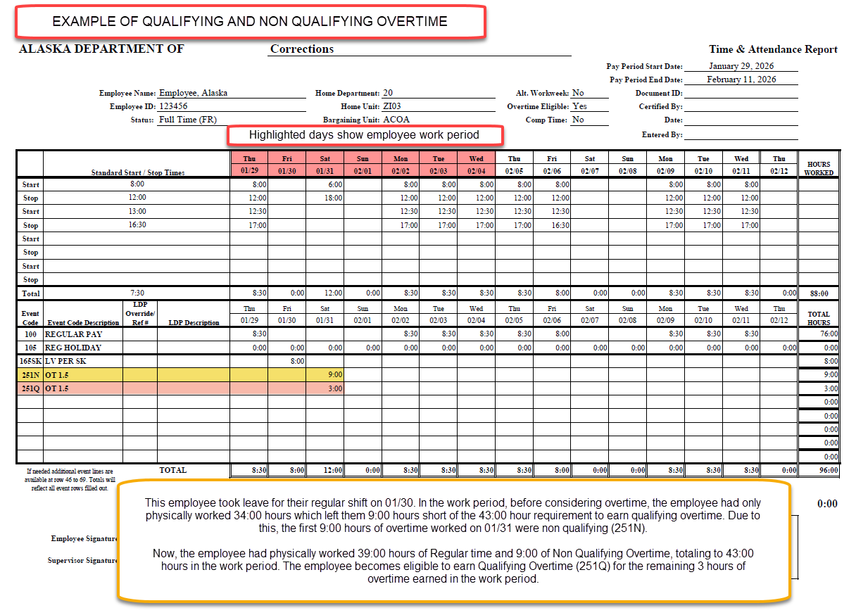
Notes:
Are we counting meal breaks as time physically worked?

Slide 31
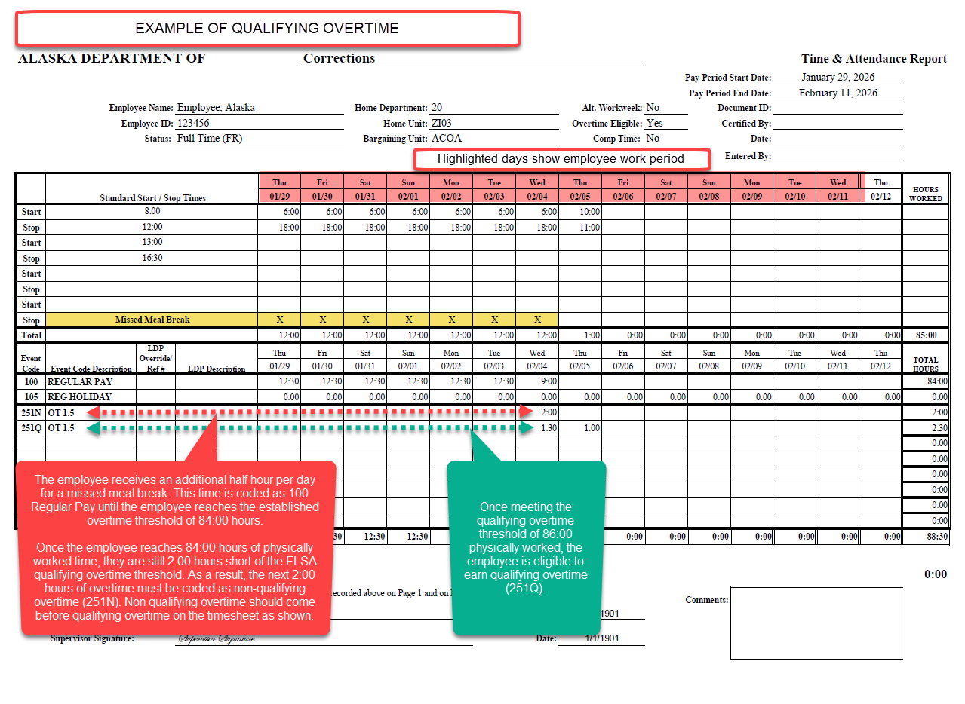

Slide 32
Holiday Premium Pay
Holiday Premium Pay is paid to employees at time and a half for hours worked on the holiday. It will be considered qualifying or non qualifying depending on if the employee has met the work period threshold to earn qualifying overtime.
In addition, all other codes tied to hours worked on the holiday—such as swing differential or grave differential—will follow the same rules. These hours are treated as non‑qualifying until the threshold is reached, and once the threshold is met, they are classified as qualifying

Slide 33
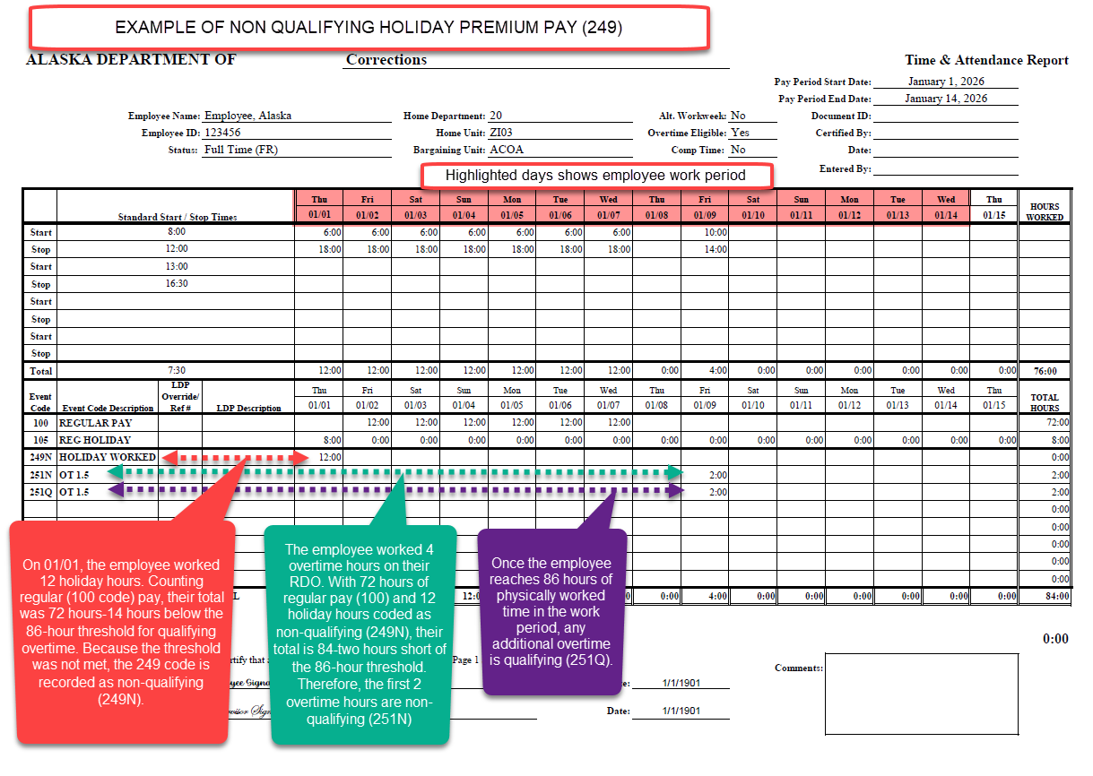

Slide 34
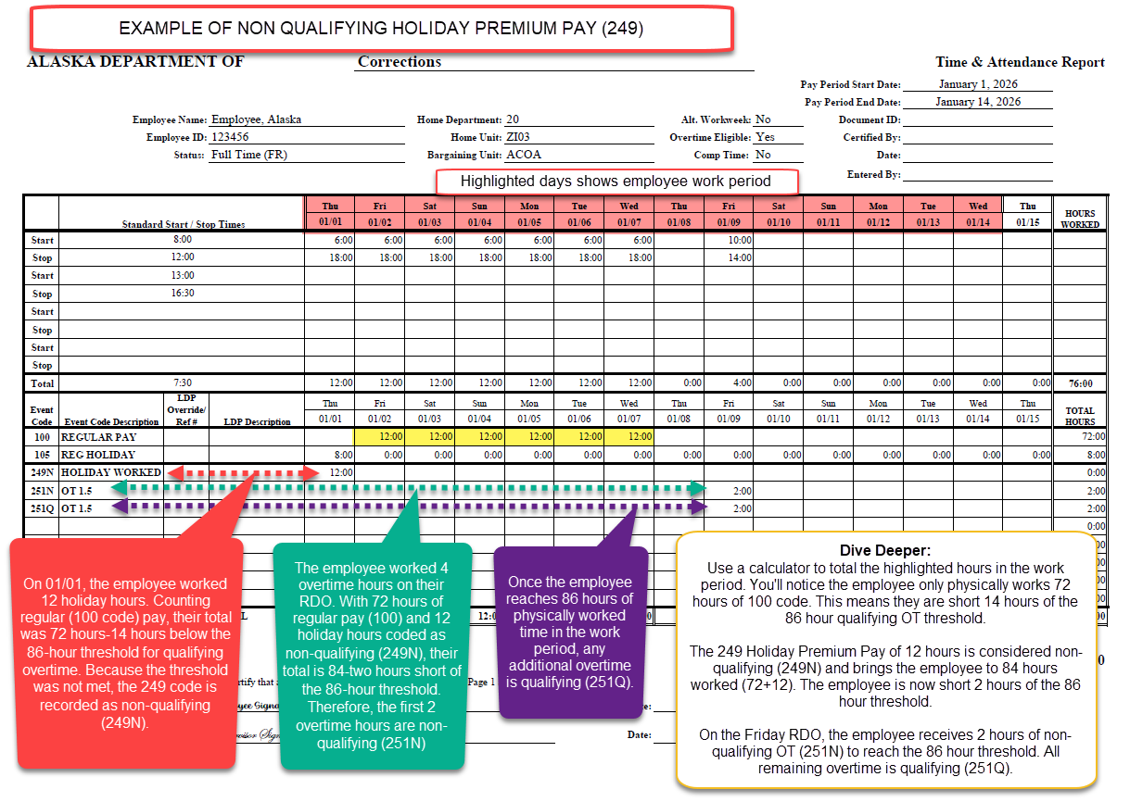

Slide 35
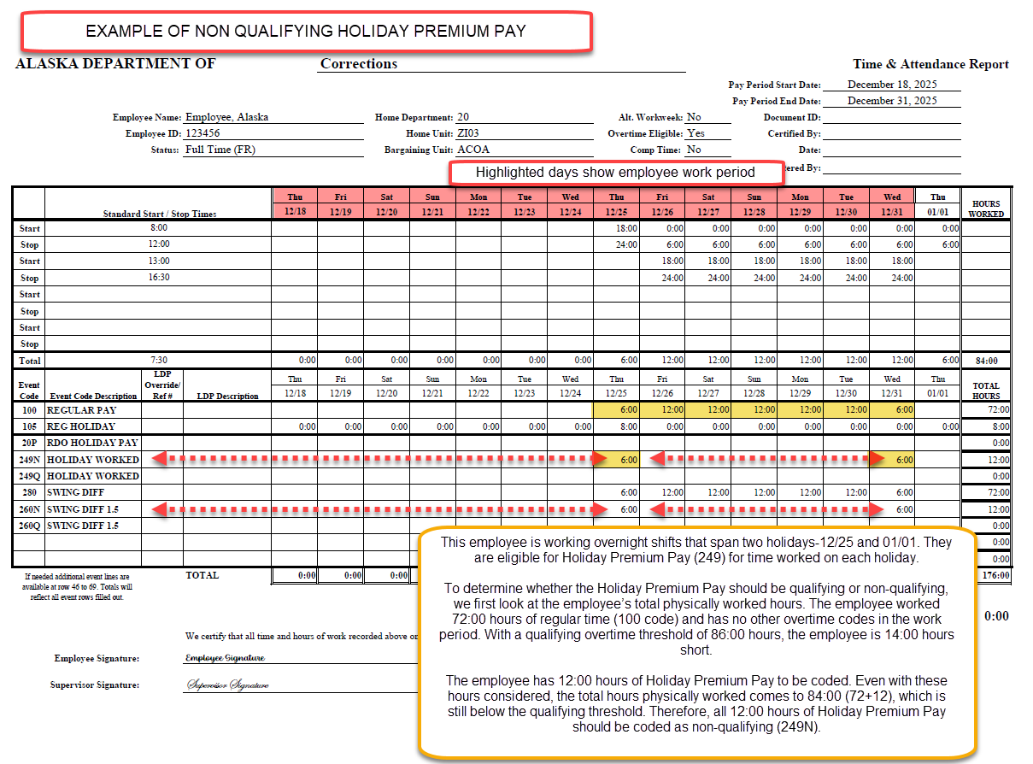

Slide 36
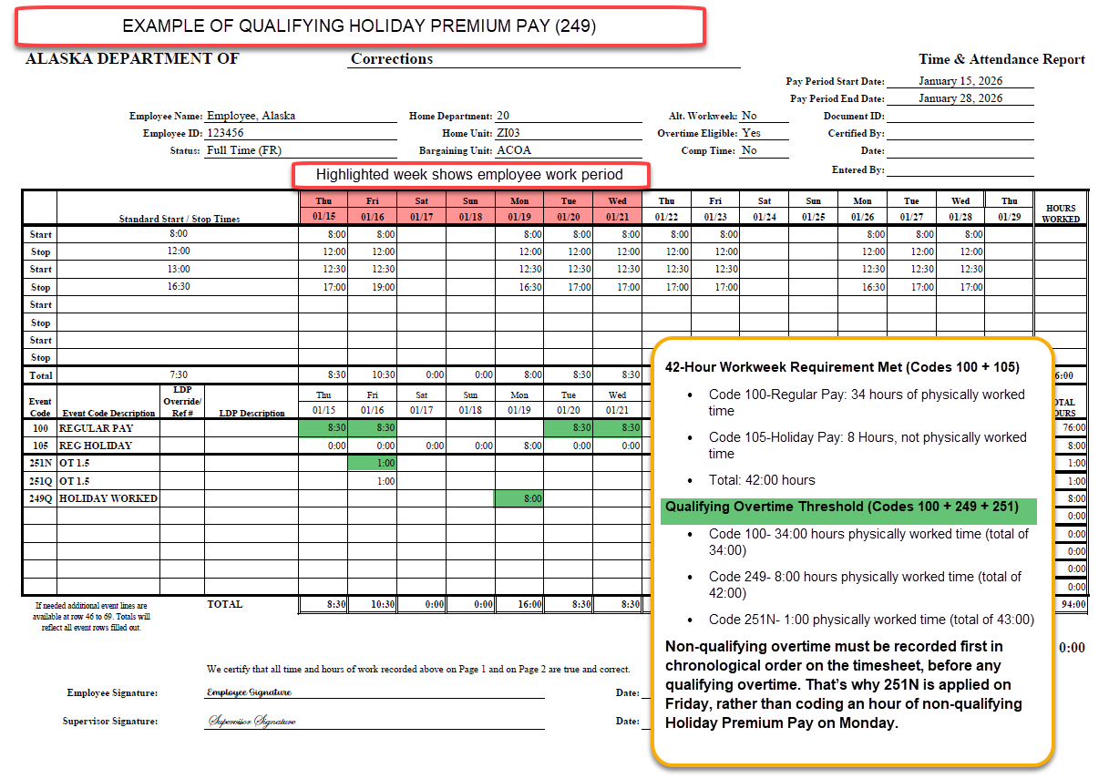

Slide 37
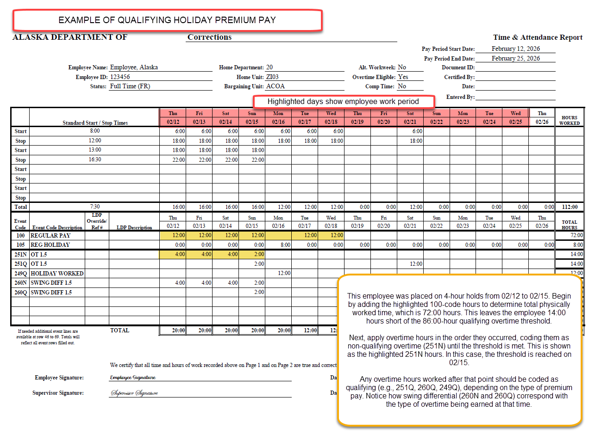

Slide 38
Shift Differentials and other Premium Pays
Important Clarification:
When an employee qualifies for a shift differential (other premium pays that correspond with hours worked) and earns overtime, the shift differential must align with the type of overtime being claimed.
If the overtime is non-qualified, the corresponding shift differential must also be non-qualified. If the overtime is qualified, the shift differential must be qualified as well.
The shift differential and overtime type should always match—they must never be recorded differently.
This includes:
Swing Differential: 260N, 260Q
Grave Differential: 270N, 270Q

Slide 39
Claiming Swing and Grave Shift Differentials
Examples:
If an employee is claiming swing shift differential in combination with non-qualified overtime (Event Code 251N), they should claim non-qualified Swing OT (Event Code 260N).
If an employee is claiming swing shift differential in combination with qualified overtime (Event Code 251Q), they should claim qualified Swing OT (Event Code 260Q).
Reminder:
They should never be recorded mismatched for the same timeframe. This applies to shift differentials corresponding with Overtime, Double Time, Holiday Premium Pay and Recall/Callback hours.

Slide 40
Event Codes – Swing and Grave Shift Differentials
Shift Type | Pay Rate Being Earned | Qualified Status | Event Code
Swing | Regular Pay Rate | N/A | 280
 | Overtime Pay Rate (1.5x) | Non-Qualified | 260N
 | Overtime Pay Rate (1.5x) | Qualified | 260Q
 | Double Pay Rate (2x) | Non-Qualified | 262N
 | Double Pay Rate (2x) | Qualified | 262Q
Grave | Regular Pay Rate | N/A | 290
 | Overtime Pay Rate (1.5x) | Non-Qualified | 270N
 | Overtime Pay Rate (1.5x) | Qualified | 270Q
 | Double Pay Rate (2x) | Non-Qualified | 272N
 | Double Pay Rate (2x) | Qualified | 272Q

Slide 41
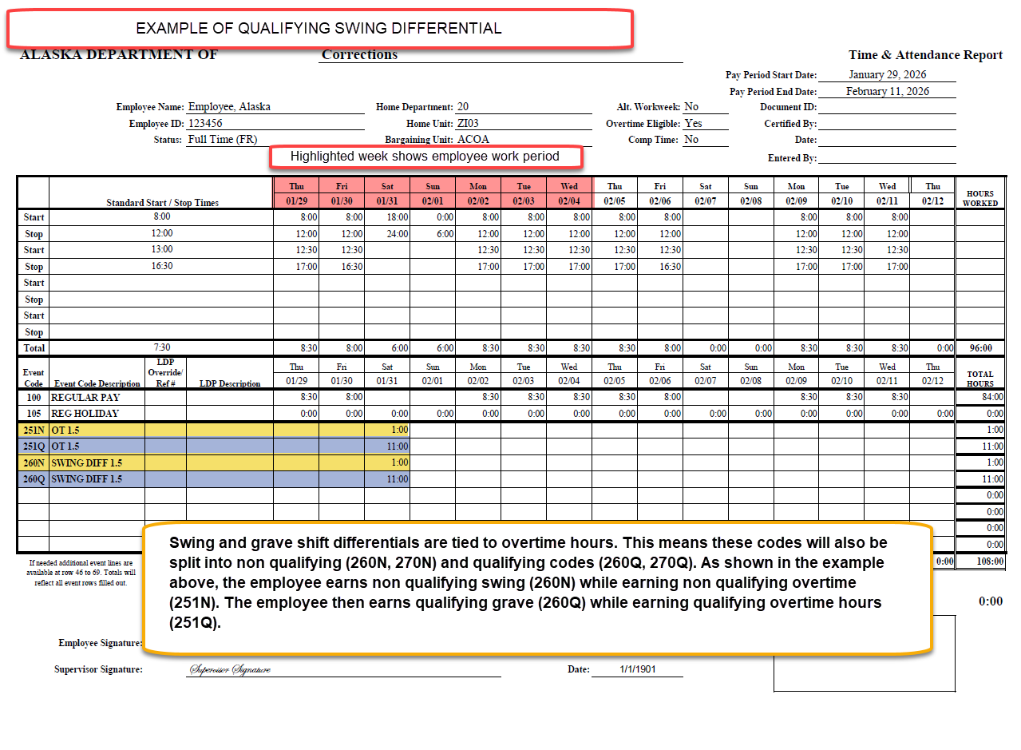

Slide 42
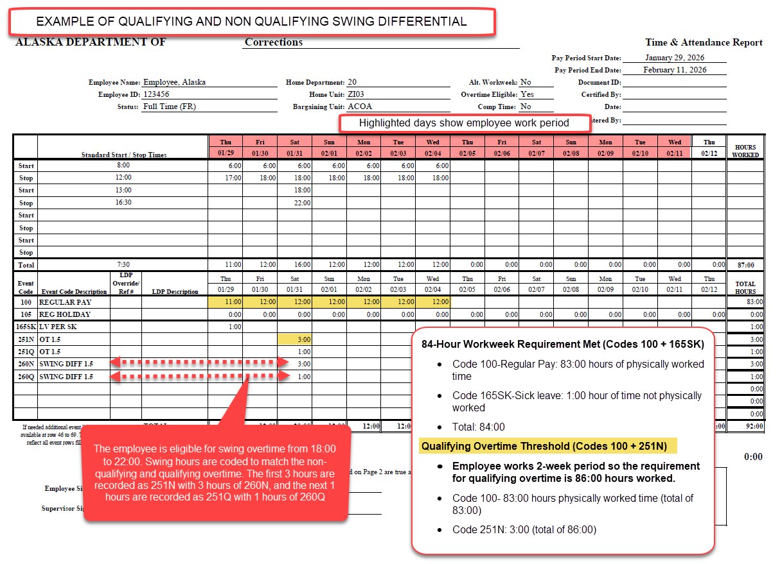

Slide 43
Recall
Since Recall time pays at time and a half and corresponds with time worked, it is also subject to nonqualifying and qualifying rules. However, this only applies to the hours of recall spent physically working.
Applicable codes for recall within 4 hours of a shift are 243N and 243Q
Applicable codes for recall later than 4 hours after completion of shift are 244N, 244Q, and 245
Recall code 245 used to meet the minimum guarantee of 3:00 hours of pay is not time spent physically working. Therefore, it will not have qualifying or non qualifying codes.

Slide 44
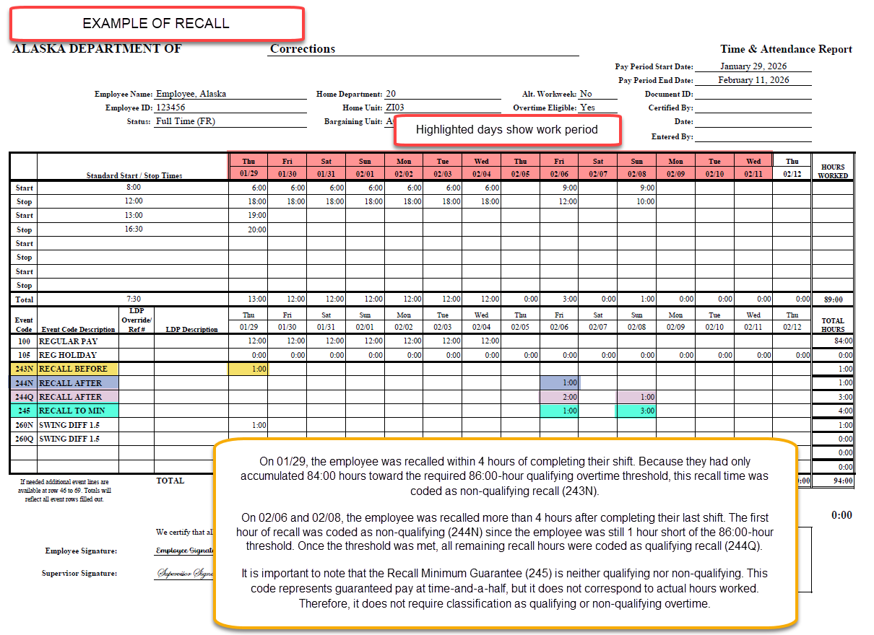

Slide 45
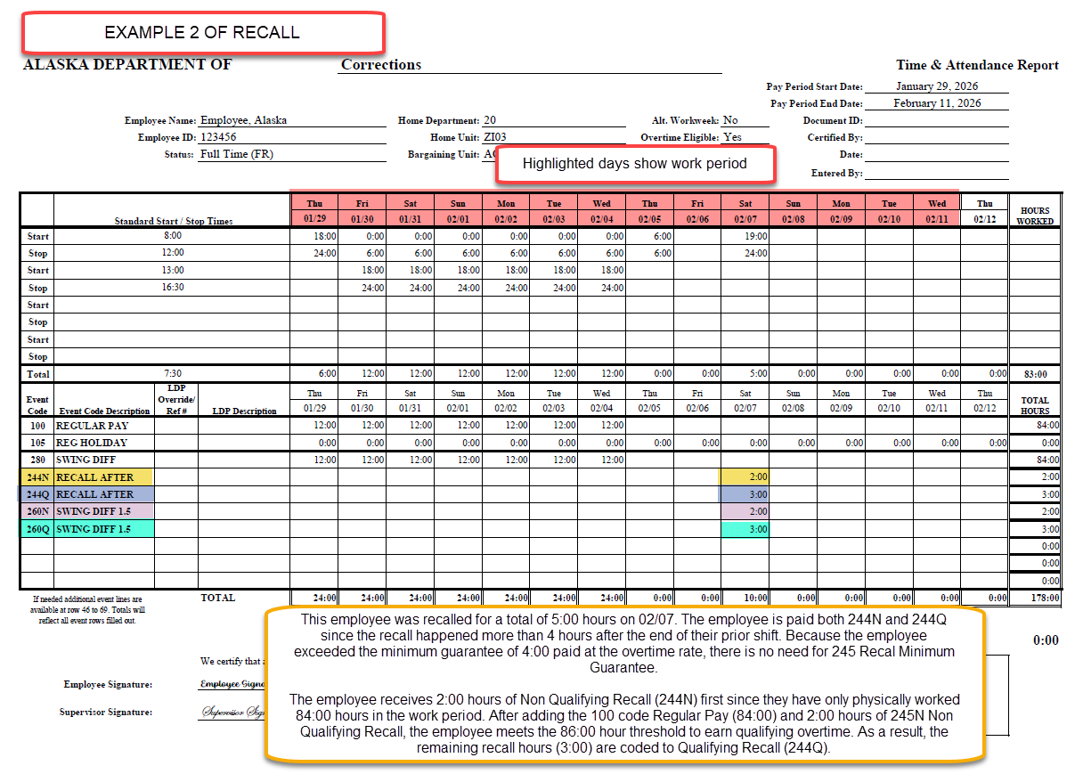

Slide 46
Claiming Overtime: PSEA Troopers
Notes:
Presentation of the final design as it could be used in production of materials for communication. First design element to be aware of is the formatting of the powerpoint theme (using the new logo).

Slide 47
Claiming Overtime: PSEA (DPS Troopers)
This section includes visual examples of how to correctly record nonqualifying and qualifying overtime on a timesheet. It is specifically intended for PSEA bargaining unit members in Department of Public Safety (DPS).
The PSEA contract specifies 1 schedule:
40-hour Schedule
5 days on/2 days off or 4 days on/3 days off
1-week work period (Sunday midnight to Sunday midnight)
Threshold for qualifying overtime is 43 hours in 1 week
PSEA also follows various alternate work weeks that can affect the work period including:
2 week on/2 week off
4-week work period
Threshold for qualifying overtime is 171 hours
84-Hour (combination of 7 days on/7 days off over 2 week period-12 hour days)
2 week work period from Sunday midnight to Sunday midnight 2 weeks later.
Threshold for qualifying overtime is 86 hours
Please note: The following examples are intended as a helpful guide only. They do not cover every possible time-reporting situation.

Slide 48
Law Enforcement FLSA Threshold per Work Period Length
The chart below outlines the FLSA qualifying overtime thresholds based on the length of the work period.
Work Period | Law Enforcement FLSA Threshold
28 days | 171 hours
21 days | 128 hours
14 days | 86 hours
7 days | 43 hours

Slide 49
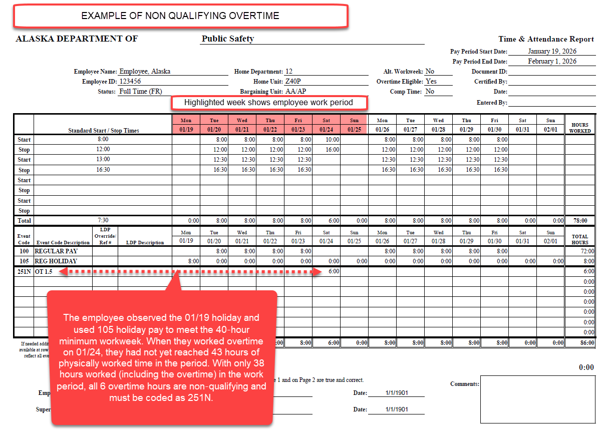

Slide 50
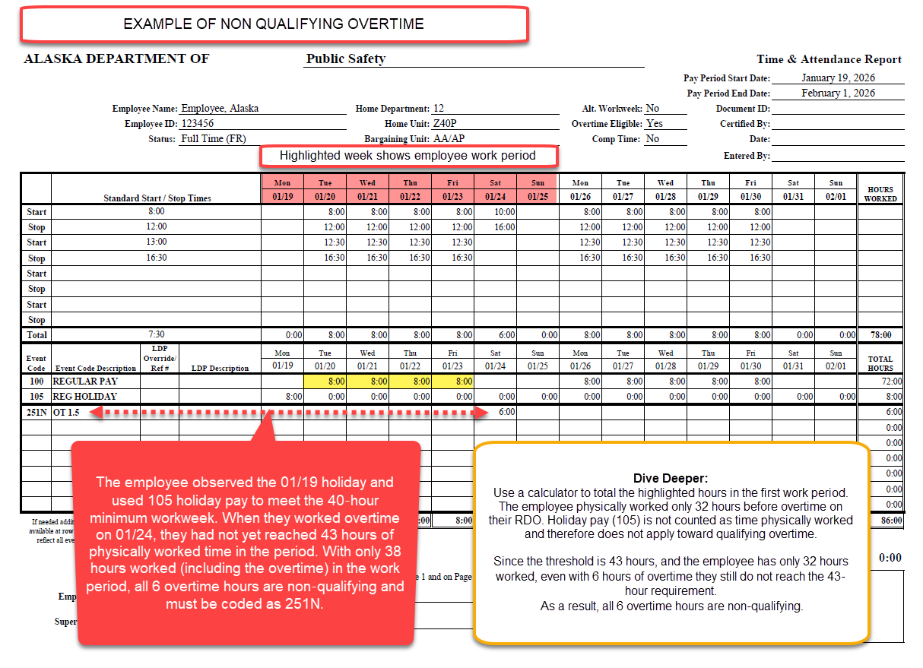

Slide 51
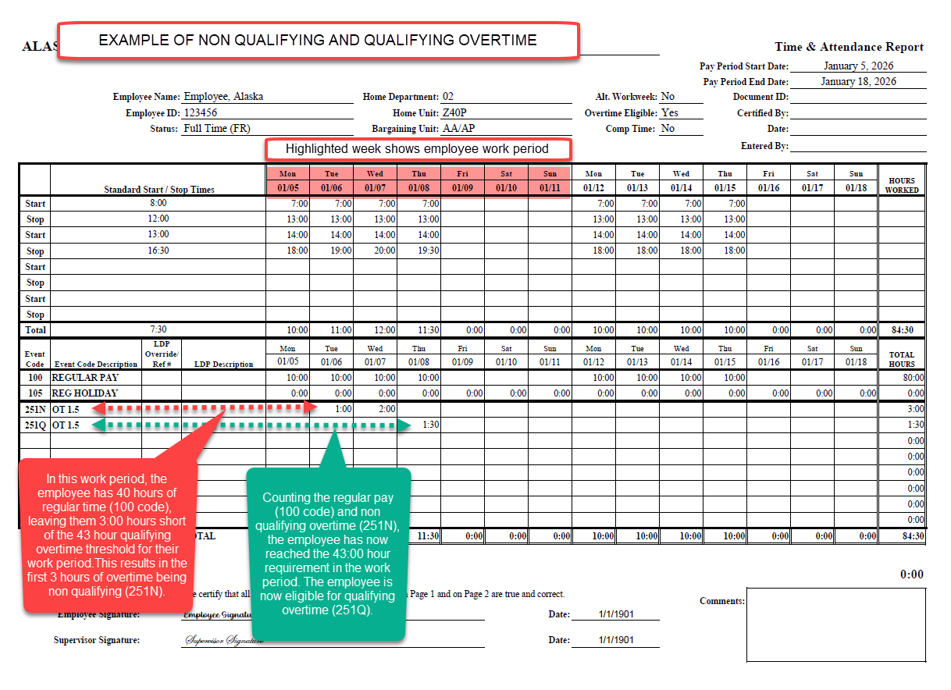

Slide 52
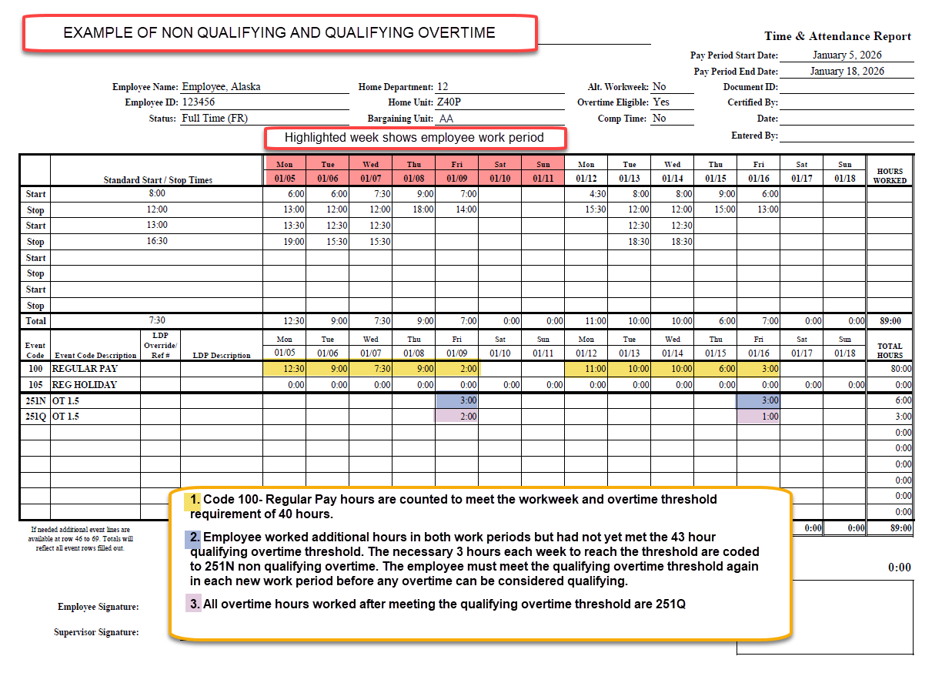

Slide 53
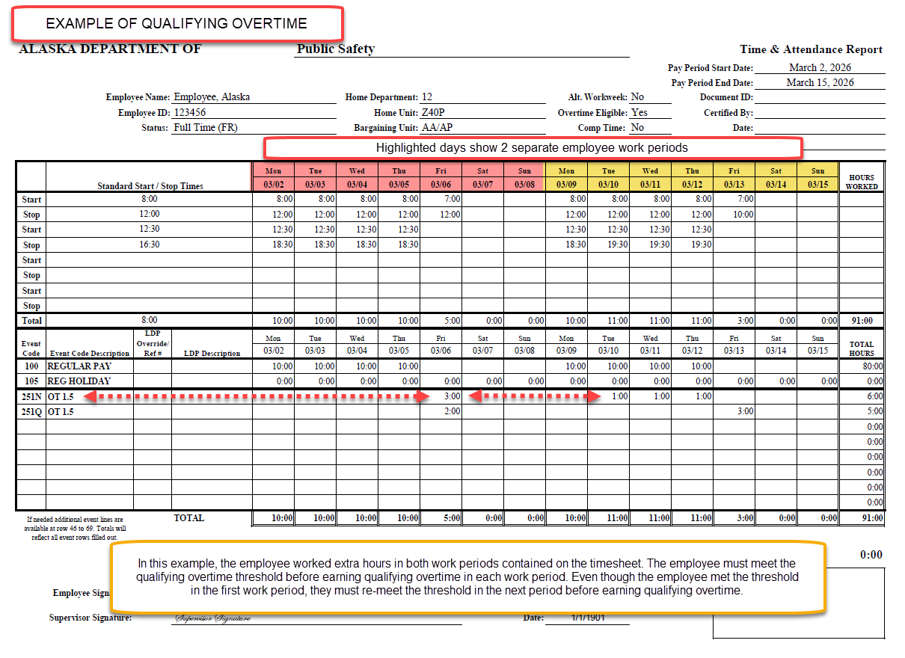

Slide 54
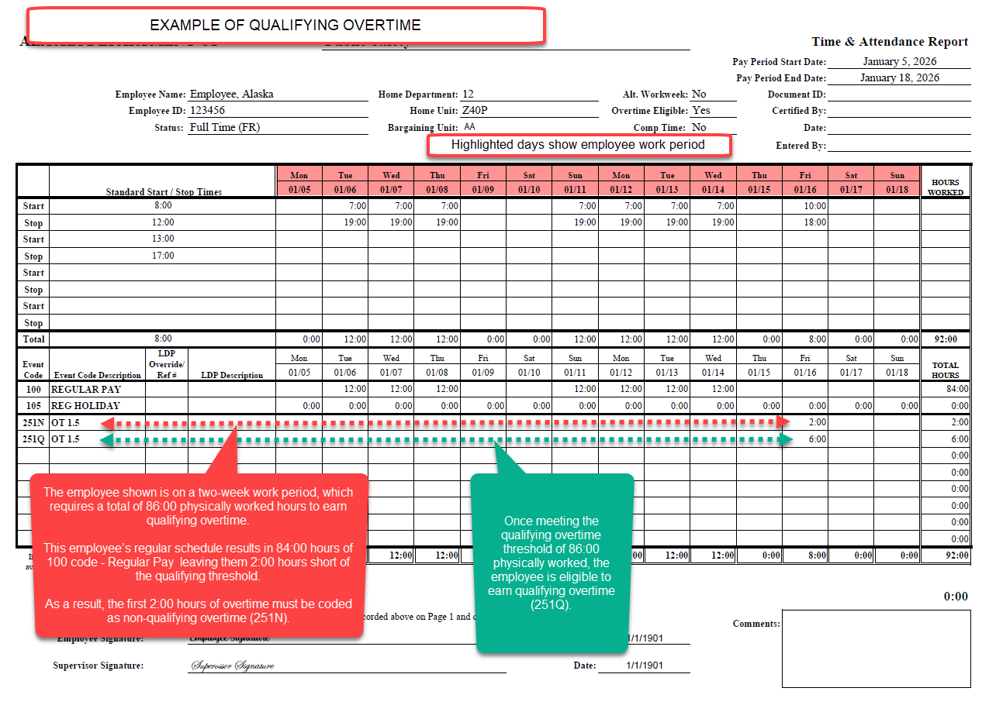

Slide 55
Double time
Double time and its corresponding codes are also subject to consideration of being nonqualifying and qualifying.
This includes the following codes:
252N and 252Q: Double Time
262N and 262Q: Swing Differential
272N and 272Q: Grave Differential
23BN and 23BQ: SERT Premium Pay
23CN and 23CQ: PILOT Premium Pay

Slide 56
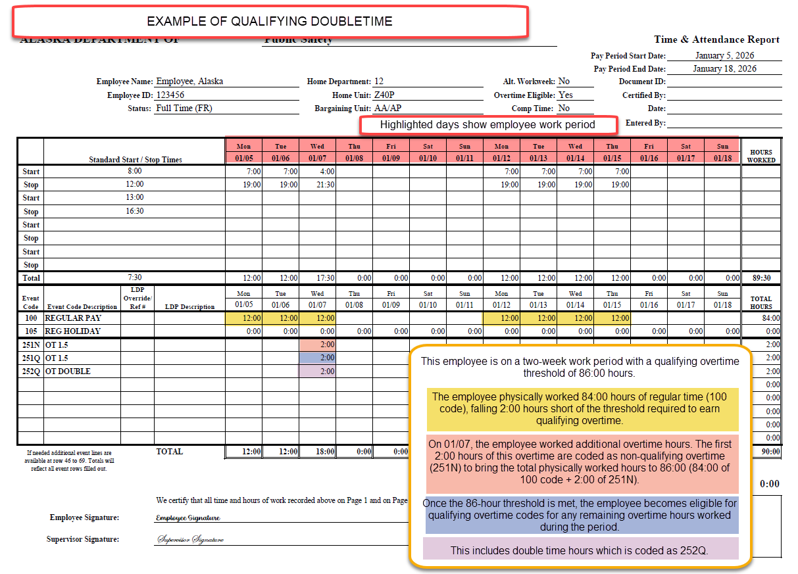

Slide 57
Holiday Premium Pay
Holiday Premium Pay is paid to employees at time and a half for hours worked on the holiday. It will be considered qualifying or non qualifying depending on if the employee has met the work period threshold to earn qualifying overtime.
In addition, all other codes tied to hours worked on the holiday—such as swing differential, grave differential, and SERT premium pay—will follow the same rules. These hours are treated as non‑qualifying until the threshold is reached, and once the threshold is met, they are classified as qualifying

Slide 58
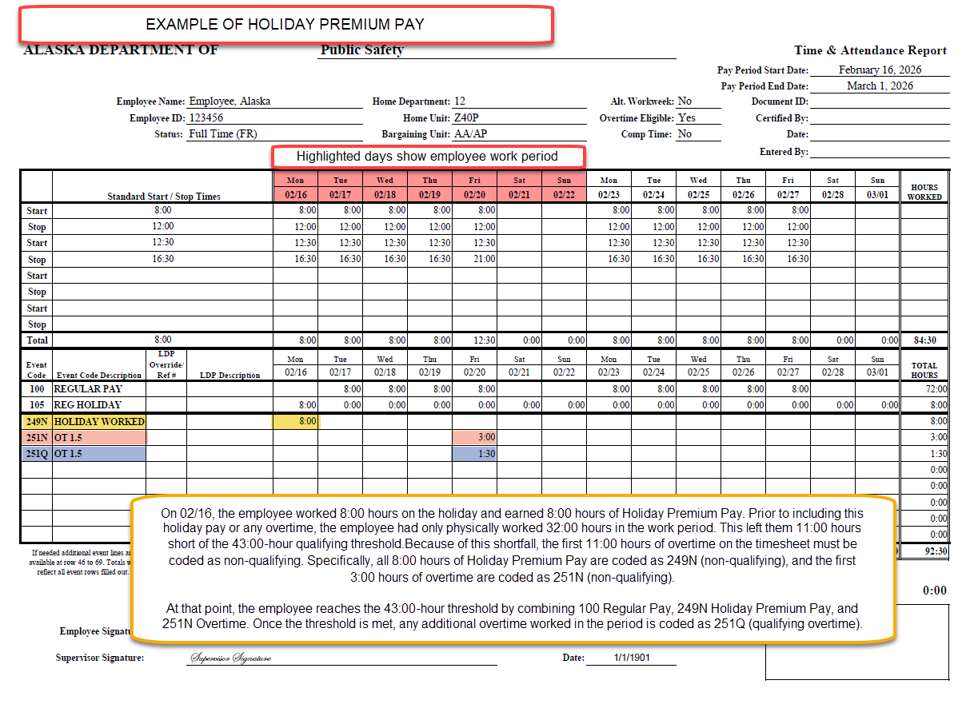

Slide 59
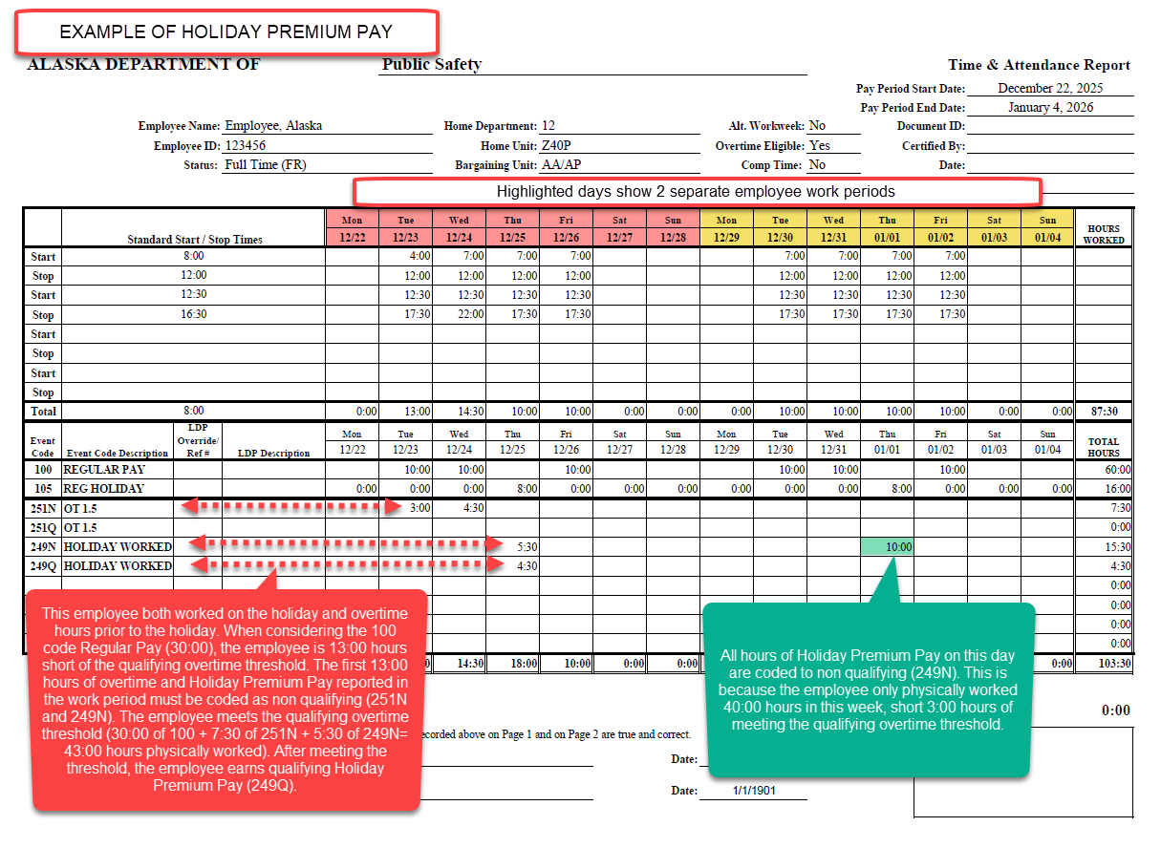

Slide 60
Determining Qualifying Overtime for 14 on/14 off Schedule
The employee is on a 28-day work period, which begins on the first regularly scheduled workday. To earn qualifying overtime, the employee must physically work 171 hours within that 28-day period.
A typical schedule of fourteen consecutive 12-hour days results in 168 hours of physically worked time, assuming the full schedule is worked as planned (no leave or holidays taken off). This leaves the employee 3:00 hours short of the qualifying overtime threshold.
Because the 28-day work period will span two or three timesheets, it is essential to review prior timesheets when determining whether overtime hours are qualifying or non-qualifying.
If the employee uses base hours not physically worked (leave, Holiday Pay 105, etc) within the defined 28-day work period, those hours do not count toward the 171-hour qualifying overtime threshold. As a result, the employee will need to work additional non-qualifying overtime hours (e.g., 251N) until they reach 171 physically worked hours. Only after meeting that threshold will any further overtime be eligible for qualifying codes.

Slide 61
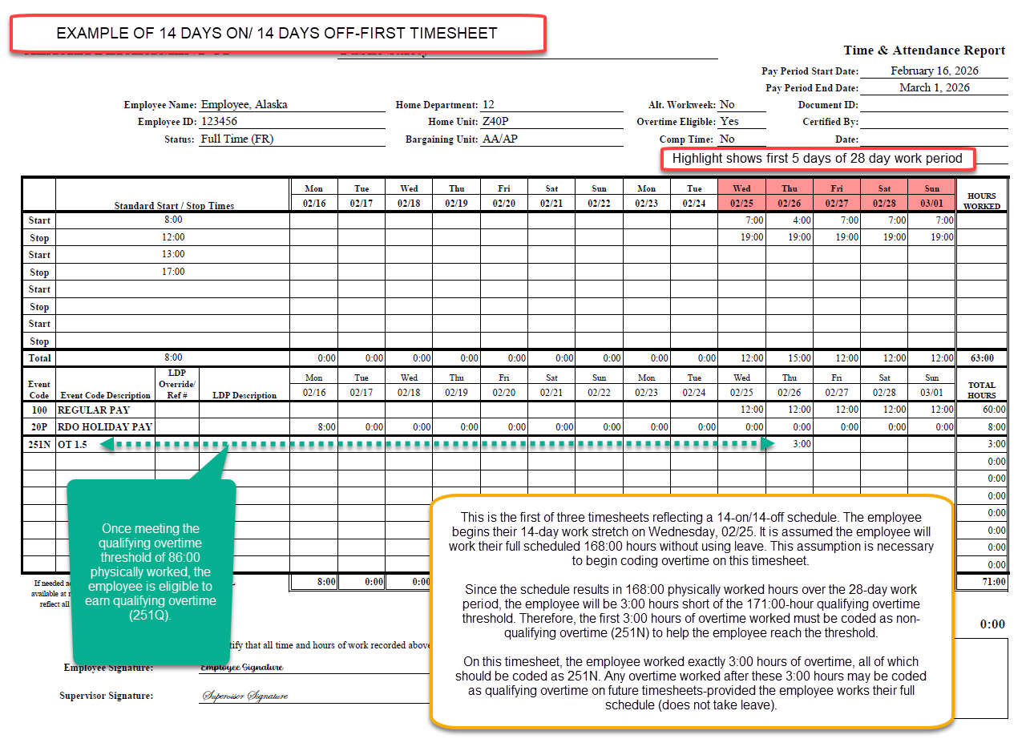

Slide 62
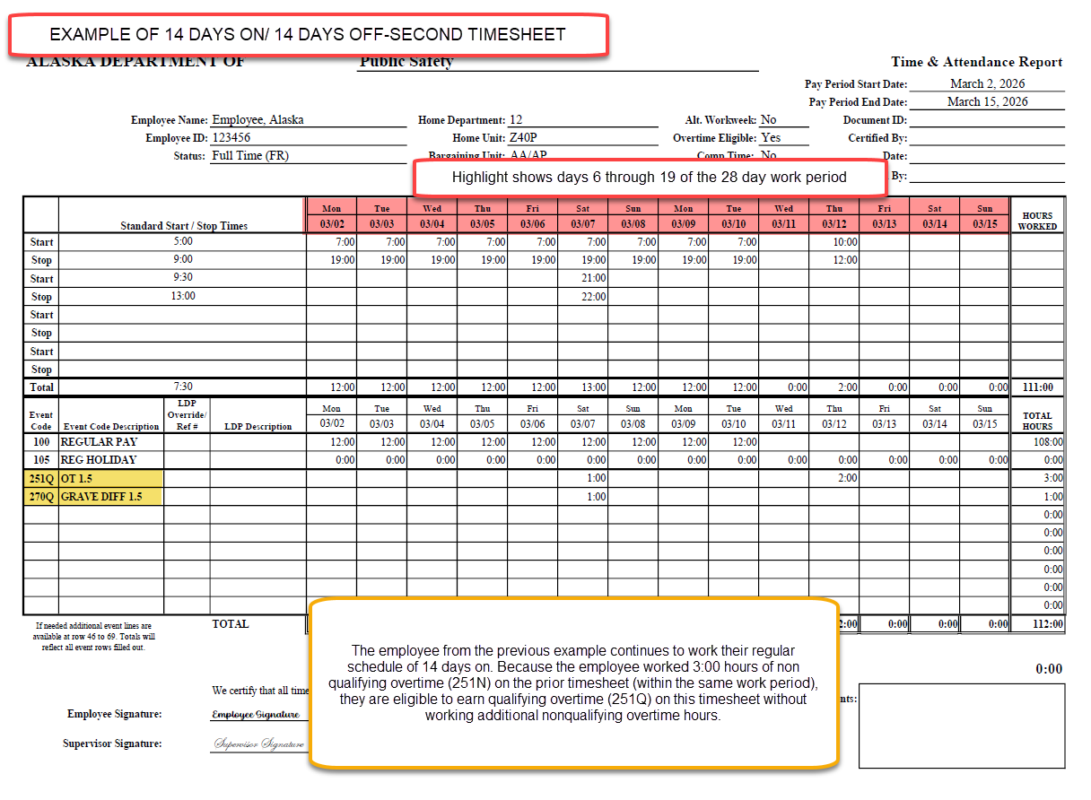

Slide 63
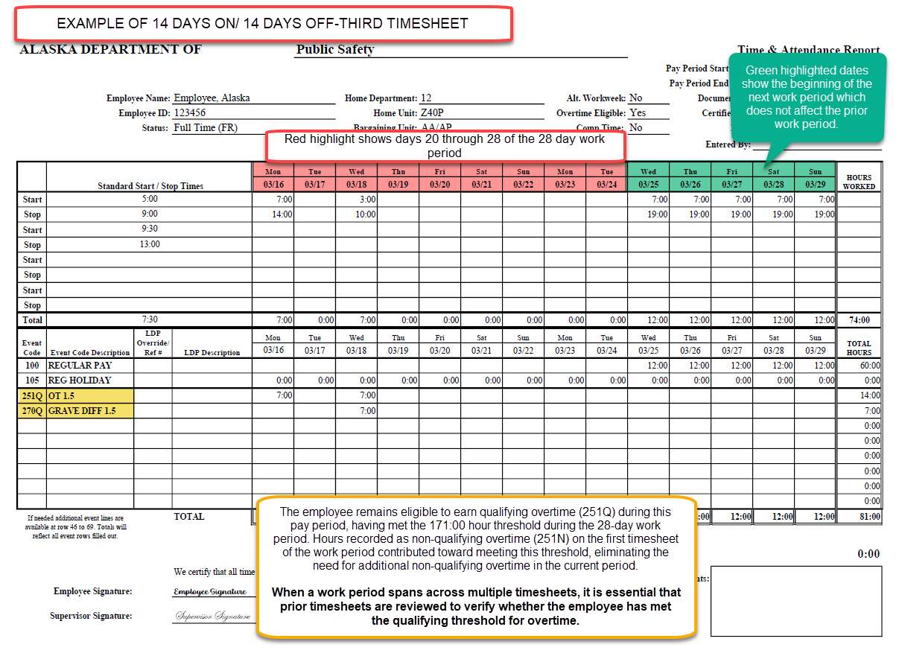

Slide 64
Shift Differentials and other Premium Pays
Important Clarification:
When an employee qualifies for a shift differential (other premium pays that correspond with hours worked) and earns overtime, the shift differential must align with the type of overtime being claimed.
If the overtime is non-qualified, the corresponding shift differential must also be non-qualified. If the overtime is qualified, the shift differential must be qualified as well.
The shift differential and overtime type should always match—they must never be recorded differently.
This includes:
Swing Differential: 260N, 260Q
Grave Differential: 270N, 270Q
SERT pay: 234N, 234Q, 23BN, 23BQ
PILOT pay: 232N, 232Q, 23CN, 23CQ

Slide 65
Claiming Swing and Grave Shift Differentials
Examples:
If an employee is claiming swing shift differential in combination with non-qualified overtime (Event Code 251N), they should claim non-qualified Swing OT (Event Code 260N).
If an employee is claiming swing shift differential in combination with qualified overtime (Event Code 251Q), they should claim qualified Swing OT (Event Code 260Q).
Reminder:
They should never be recorded mismatched for the same timeframe. This applies to shift differentials corresponding with Overtime, Double Time, Holiday Premium Pay and Recall/Callback hours.

Slide 66
Event Codes – Swing and Grave Shift Differentials
Shift Type | Pay Rate Being Earned | Qualified Status | Event Code
Swing | Regular Pay Rate | N/A | 280
 | Overtime Pay Rate (1.5x) | Non-Qualified | 260N
 | Overtime Pay Rate (1.5x) | Qualified | 260Q
 | Double Pay Rate (2x) | Non-Qualified | 262N
 | Double Pay Rate (2x) | Qualified | 262Q
Grave | Regular Pay Rate | N/A | 290
 | Overtime Pay Rate (1.5x) | Non-Qualified | 270N
 | Overtime Pay Rate (1.5x) | Qualified | 270Q
 | Double Pay Rate (2x) | Non-Qualified | 272N
 | Double Pay Rate (2x) | Qualified | 272Q

Slide 67
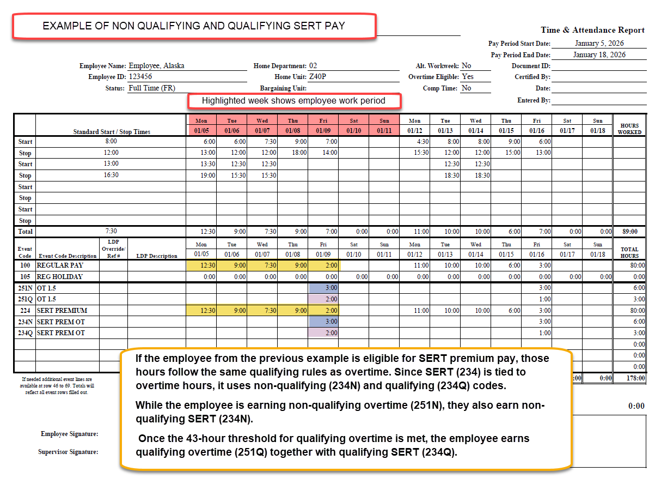

Slide 68
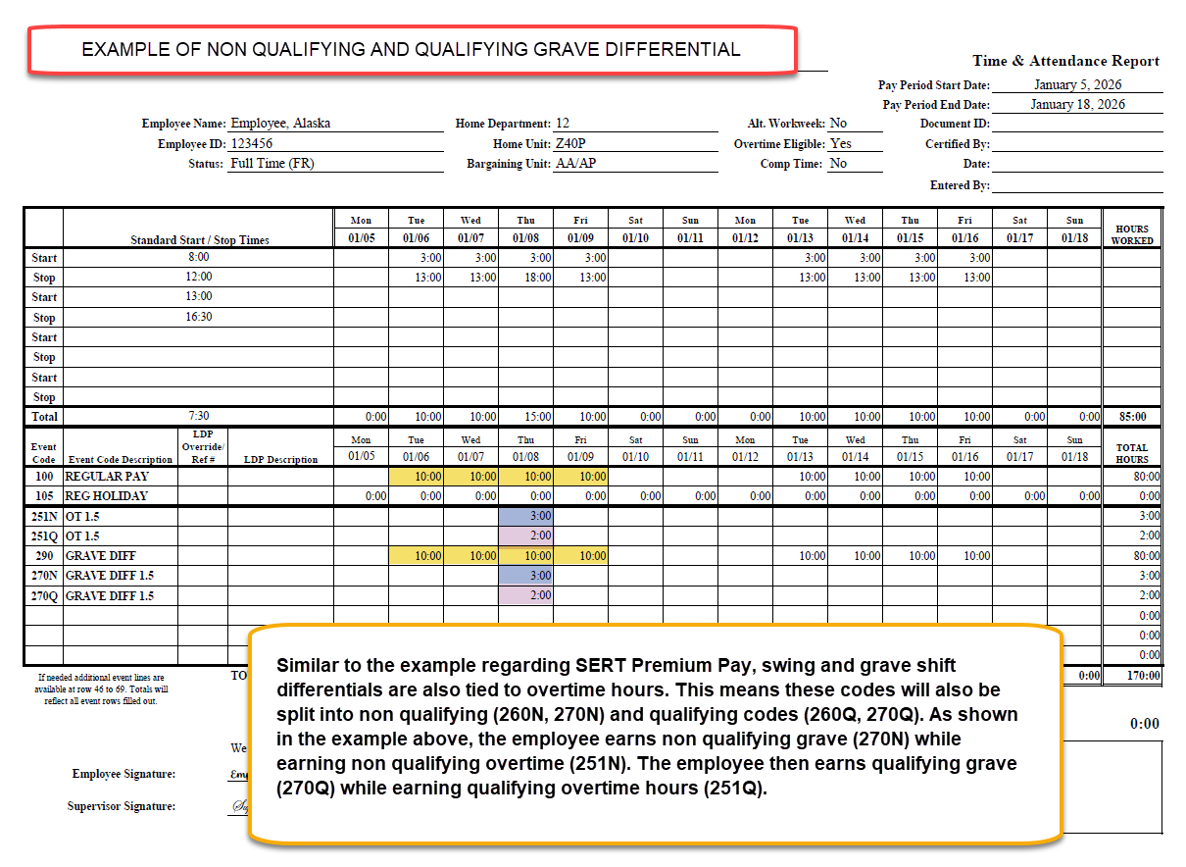

Slide 69
Recall
Since Recall time pays at time and a half and corresponds with time worked, it is also subject to nonqualifying and qualifying rules. However, this only applies to the hours of recall spent physically working
Applicable codes are 244N and 244Q
Recall code 245 used to meet the minimum guarantee of 3:00 hours of pay is not time spent physically working. Therefore, it will not have qualifying or non qualifying codes.

Slide 70
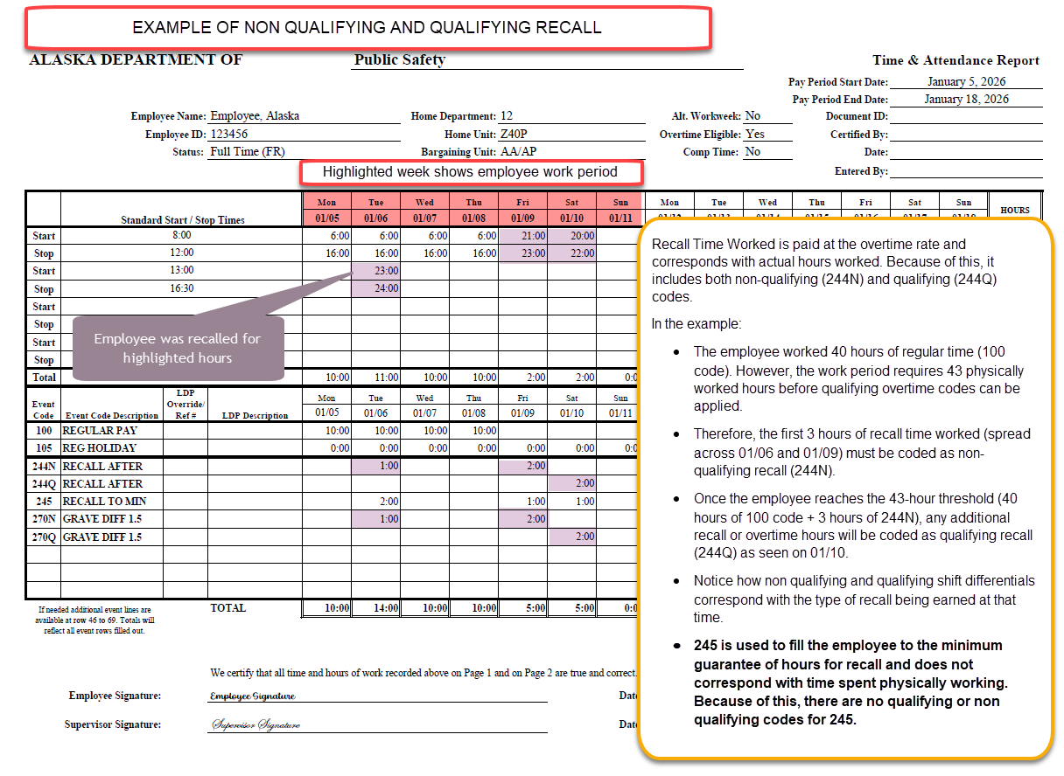

Slide 71
Academy Pay
Regular Academy Pay (109) will not utilize nonqualifying or qualifying codes since it is paid at the regular rate of pay.
Academy Pay Overtime will be coded as nonqualifying (299N) and qualifying (299Q) depending on if the employee has met the qualifying overtime threshold for their work period. This is because Academy Pay Overtime is hours worked at the time and a half rate.
Academy Pay will continue to be paid based on Collective Bargaining Agreement calculated rates rather than the employee’s typical hourly rate. Academy Pay Overtime will also be based off this calculated rate. For more information, see PSEA Contract Article 15.02.B.4.

Slide 72
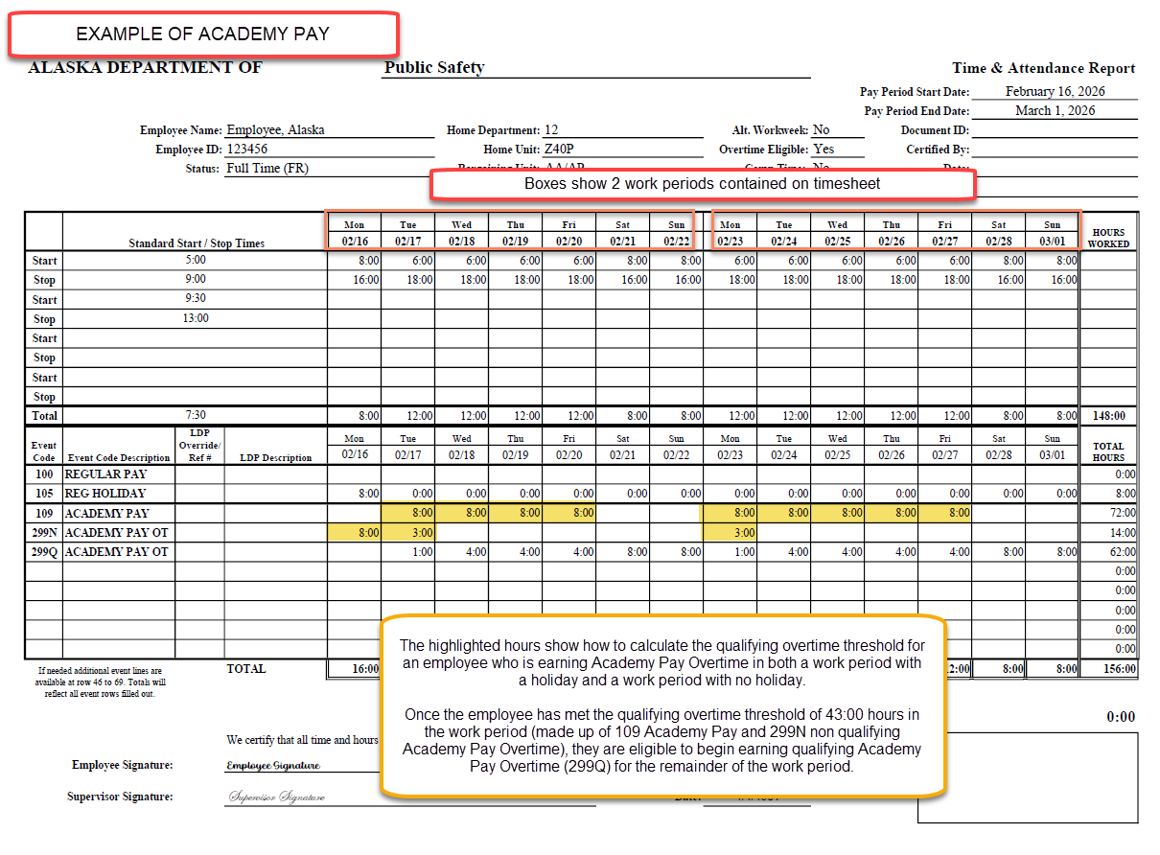

Slide 73
PSEA- DOT APFO Specific Information
Guidance specific to PSEA employees within the Department of Transportation will be provided in a future update.

