Slide 1
Leave Accruals in TIMEI, TADI, and TIMEG Transactions
Floated Holiday Accruals, Flex leave, and Compensatory (Comp) leave

Slide 2
Table of contents
Available Resources………………………………………3
General Information………………….………………….4
Floated Holiday Accrual………………………………..5
Flex Accrual………………………………………….………8
Compensatory (Comp) Time……………………….13
Special Considerations………………………………..24

Slide 3
Resources
Collective Bargaining Agreements
  Review for specific provisions related to timekeeping and compensation.
Personnel Rules
  Review specific provisions related to timekeeping and compensation.
Alaska Administrative Manual (AAM)
  Reference official procedures and standards for state operations.
Division of Finance – Payroll
  Use additional resources and references available to State of Alaska employees.
DOF Overtime Reporting Changes
  Guidance on determining qualified vs. non-qualified overtime and access to the most current timesheet template.
HR Forms & Resources
  Access to resources and forms, including those for floated holidays and flex time plans.

Slide 4
General Information
Beginning 02/16/2026 (02/12/2026 for ACOA), leave accruals for flex leave, comp leave, and floated holidays will be entered directly on the TIMEI, TADI, and TIMEG transactions, either by the employee if utilizing ESS or by the timekeeper.
This change will eliminate the need for Payroll to manually add leave accruals for regular timesheet processing.
Regular personal leave accruals will still be automatically added to the leave balance and do not need to be added to the transaction. Only Floated Holiday, Flex leave, and Comp Time accruals are affected by this change.

Slide 5
Floated Holiday
An eligible employee who works on the holiday and elects to float will now have both the hours worked and the personal leave accrual entered into their TIMEI transaction. This will be entered by the employee if utilizing ESS or by the timekeeper if not utilizing ESS.
Event Code entered into transaction: FH
Amount:
  GGU, PX, EX- 7:30
  CEA, SU, LTC, GZ- 8:00
The FH hours are to be posted on the observed holiday.
If required by the Collective Bargaining Agreement, the floated holiday agreement must be attached to the TIMEI if ESS or included in the home unit if not ESS.
FH does not replace the coding for hours worked on that day. FH is only used for the accrual of personal leave due for working on the holiday.
  For example, an SU employee who works on the holiday for 8:00 and is electing to float the holiday would have:
    8:00 hours of FH
    8:00 of applicable code for time worked (100 Regular Pay, XSREG, etc.)
The TIMEI will automatically generate with 105 Holiday Pay. This will need to be removed. The employee cannot earn 105 Holiday Pay if floating the holiday.

Slide 6
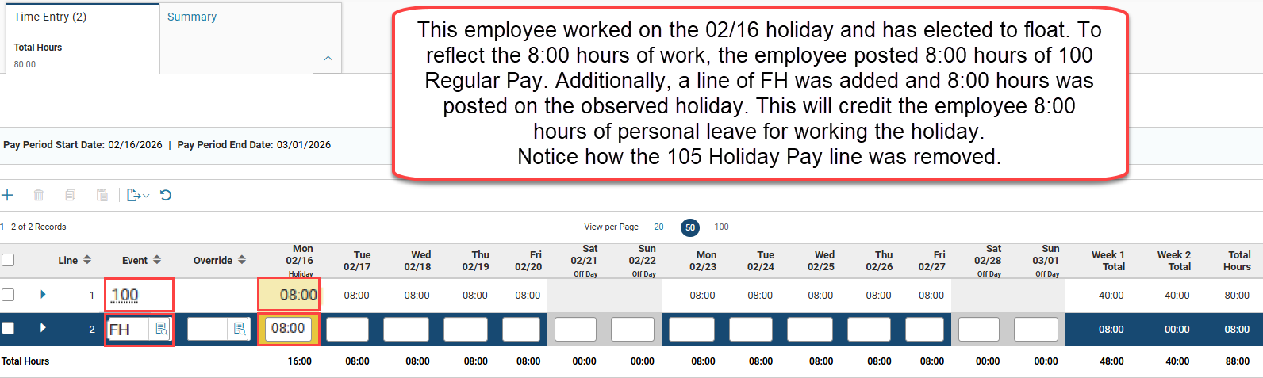
Example of FH in TIMEI

Slide 7
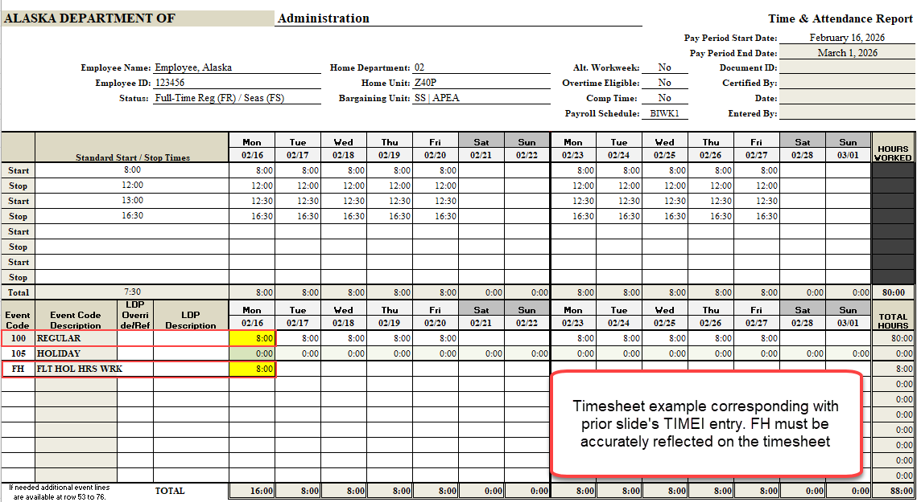
Example of FH on Timesheet

Slide 8
Flex Accruals
Overtime ineligible employees on a flex time plan will now have their flex leave accruals entered directly into their TIMEI transaction. This will be done by the employee if utilizing ESS or by the timekeeper if not utilizing ESS.
Event Code entered into transaction: 944
Amount: Refer to the flex tracking sheet to determine the correct number of accrual hours and enter that amount on the transaction.
The 944 Flex Accrual hours are posted on the last day of the workweek in which the hours were earned. This will be on Sunday unless the employee is on an Alternate Work Week that changes when the workweek begins and ends.
The flex tracking sheet will still need to be attached to the ESS entry or included with the home unit.
XSREG hours should still be entered on the transaction to reflect the extra hours worked on the appropriate days.

Slide 9
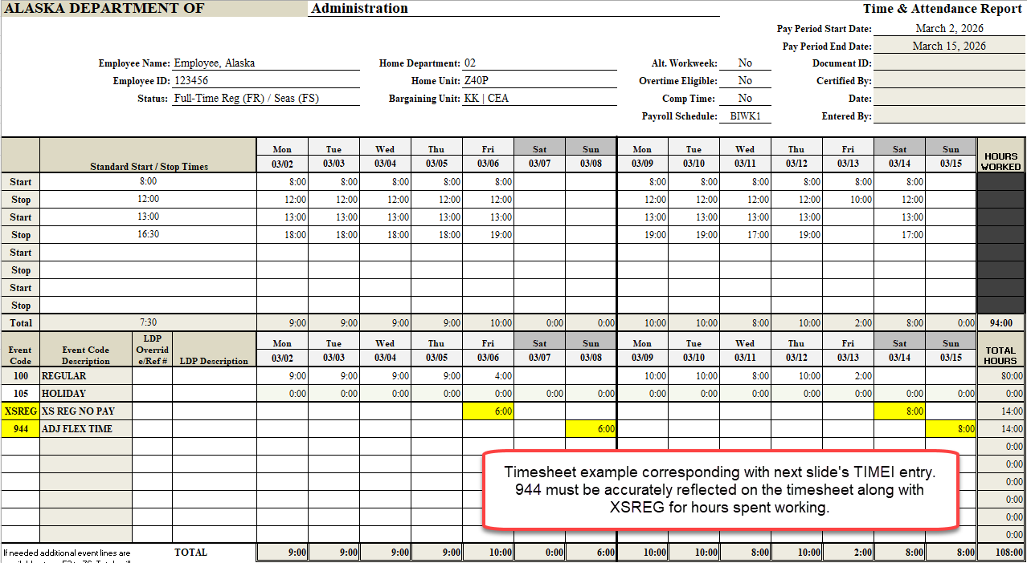
Flex Accrual on Timesheet- Example 1

Slide 10
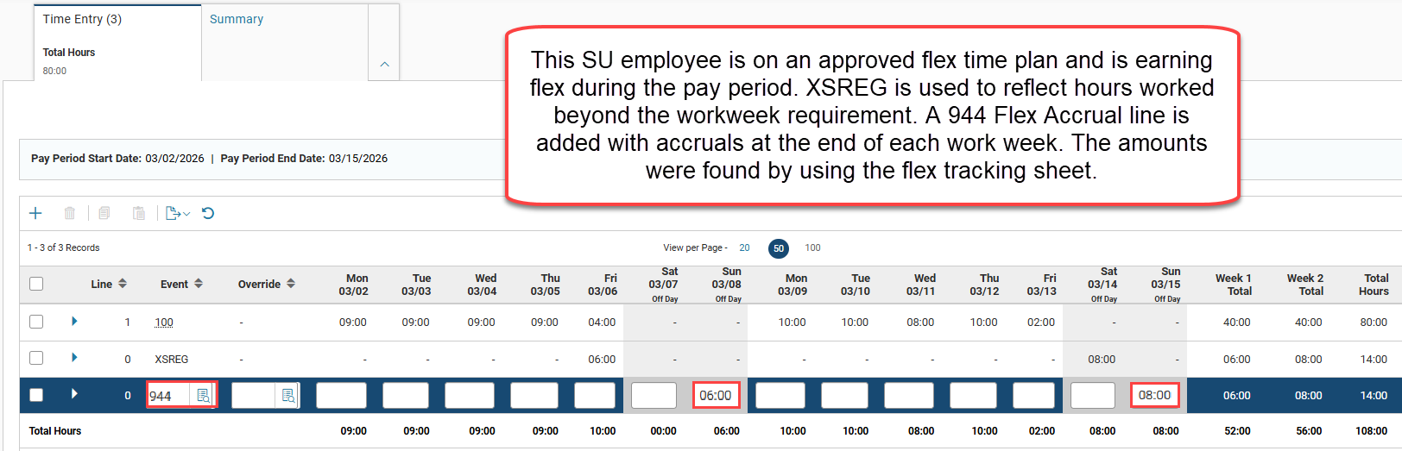
Flex Accrual in TIMEI- Example 1

Slide 11
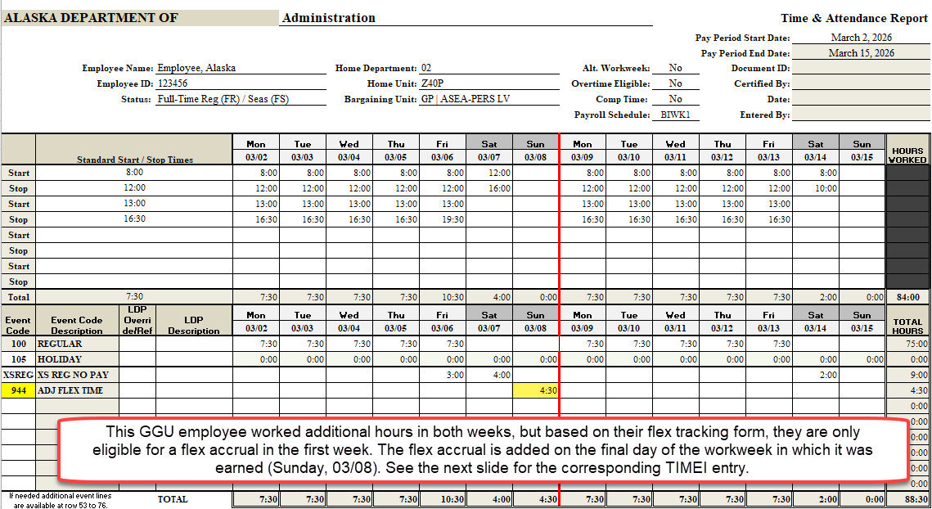
Flex Accrual on Timesheet- Example 2

Slide 12
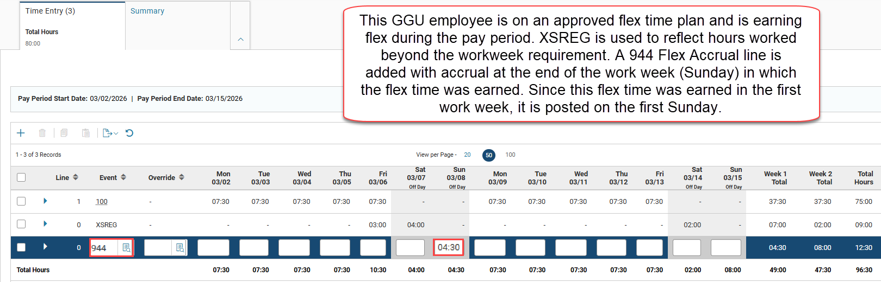
Flex Accrual in TIMEI- Example 2

Slide 13
Compensatory (Comp) Time
Employees earning comp time will now have the accrual entered directly into the TIMEI, TADI, and TIMEG transactions. This will be entered by either the employee if utilizing ESS or by the timekeeper if not utilizing ESS.
A timesheet must still be included with the home unit or as an attachment in ESS if working overtime hours and earning comp time.
Since comp time is earned in lieu of overtime, the accrual must be recorded as non-qualified or qualified. Non-qualified and qualified comp time accrual is represented by different event codes in the transaction.
If the employee would have earned non-qualified overtime, then the comp time accrual is non-qualifying.
If the employee would have earned qualified overtime, then the comp time accrual is qualified.
To represent qualified or non-qualified accruals, N and Q codes will be used. For coding, see slides 15-16.
Notes:
Add slide number when done

Slide 14
Compensatory (Comp) Time Continued
Non-qualified and qualified comp time are tracked separately in IRIS. However, the total amount of comp time that an employee is allowed to accrue per their Collective Bargaining Agreement will not change. Non-qualified comp time will always be used before qualified comp time.
Information on how to determine if overtime is non-qualified or qualified can be found on the DOF website at the following link:
  https://doa.alaska.gov/dof/payroll/ot_reporting.html

Slide 15
Compensatory (Comp) Time in Lieu of Overtime
Event Codes:
  CMPN: Comp time accrued in lieu of non-qualified overtime
  CMPQ: Comp time accrued in lieu of qualified overtime
Amount:
  Number of hours worked beyond the overtime threshold (3:00 hours of overtime worked −> enter 3:00 hours in the transaction)
  Do not multiply the amount of overtime hours worked by 1.5x. IRIS will automatically calculate the correct amount of comp time to be added to the leave bank based on the number of overtime hours worked.
The comp time accrual should be posted in the same manner as overtime– only the code is changing. Ensure employee has met their overtime threshold per the Collective Bargaining Agreement when posting comp time on the timesheet.

Slide 16
Compensatory (Comp) Time in Lieu of Straight Time
The Collective Bargaining Agreements for CEA allows for converting straight time to comp time at a 1:1 ratio. Because it is a 1:1 ratio, a different event code will be used in the TIMEI.
Event Code: CMPST
Amount: Enter the number of hours of straight time worked (worked 1:15 hours of straight time -- enter 1:15 hours into the transaction)
If the employee also has overtime that is being converted to comp time, in addition to the straight time, ensure the correct codes (CMPN/CMPQ) are being used

Slide 17
Compensatory (Comp) Time- Continued
Employees must accurately report event codes CMPN, CMPQ, and CMPST and hours on their timesheets when earning comp time.
If an employee is electing to comp their straight and/or overtime, it is important to only code the applicable comp event code (CMPST, CMPN, CMPQ) for the additional hours worked.
  For example: If an employee is electing to comp all 3:00 hours of their qualified overtime for a full pay period, the timesheet should reflect only 3:00 hours of CMPQ. There should be no 251Q on the timesheet.
Ensure other premium pay codes (such as shift differentials) are still included on the TIMEI.

Slide 18
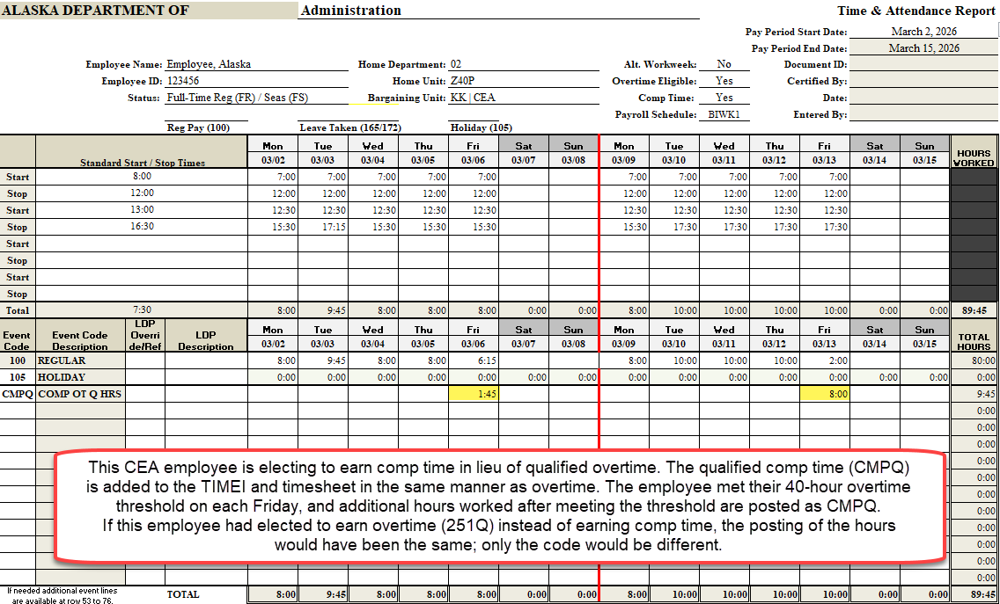
Example 1- Qualified Comp Time Timesheet

Slide 19
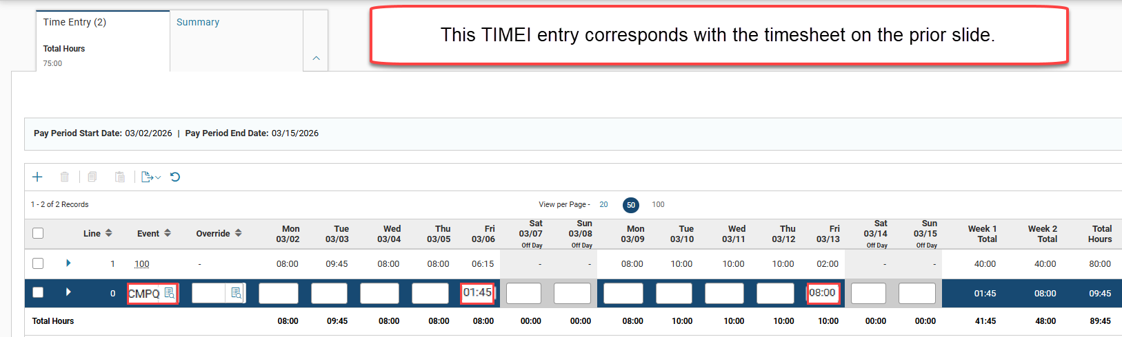
Example 1- Qualified Comp Time in TIMEI

Slide 20
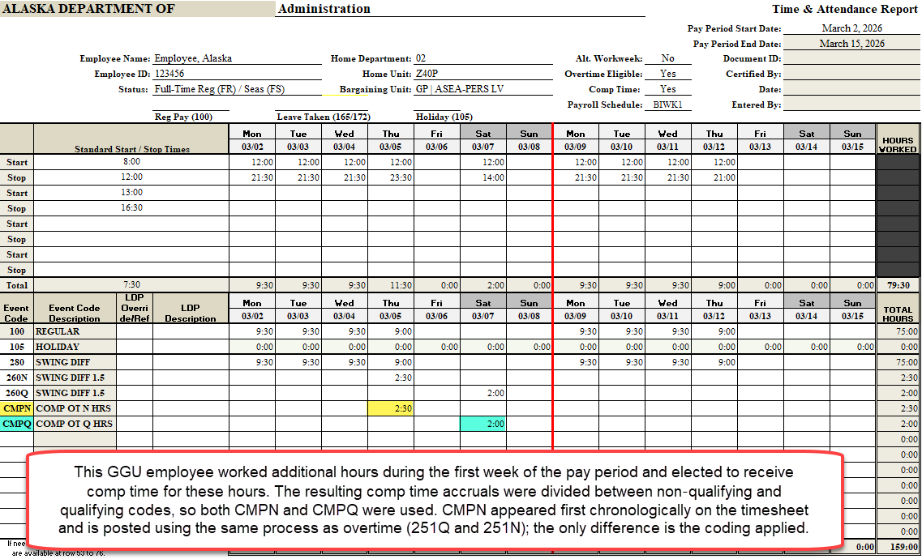
Example 2- Non-Qualified and Qualified Comp Time

Slide 21
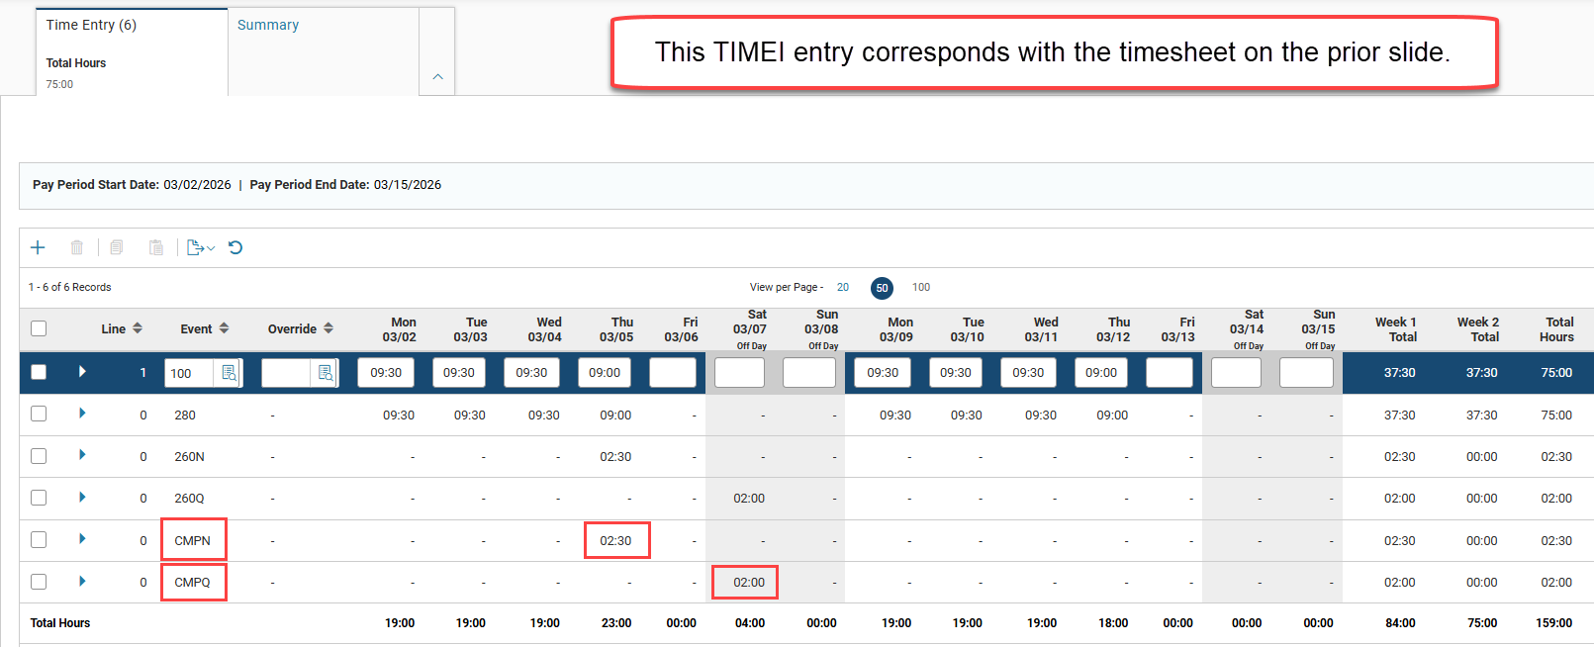
Example 2- Non-Qualified and Qualified Comp Time on TIMEI

Slide 22
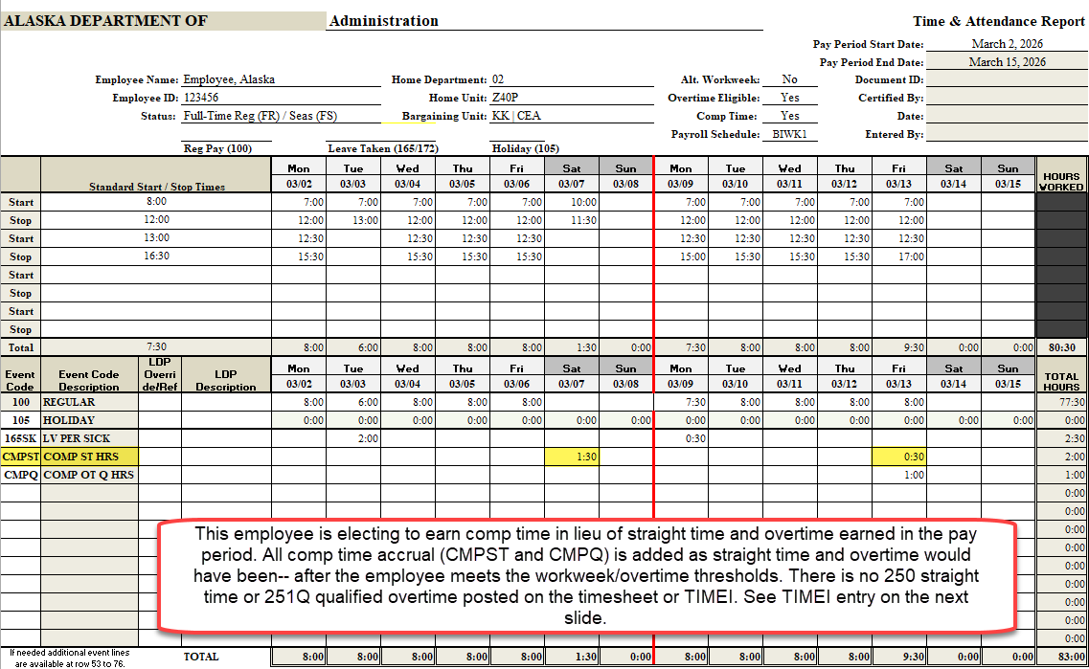
Example 3- Comp for Straight Time (CMPST) Timesheet

Slide 23
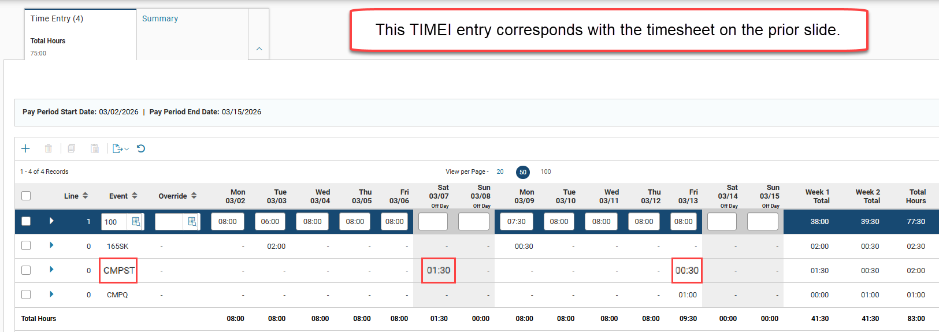
Example 3- Comp for Straight Time (CMPST) TIMEI entry

Slide 24
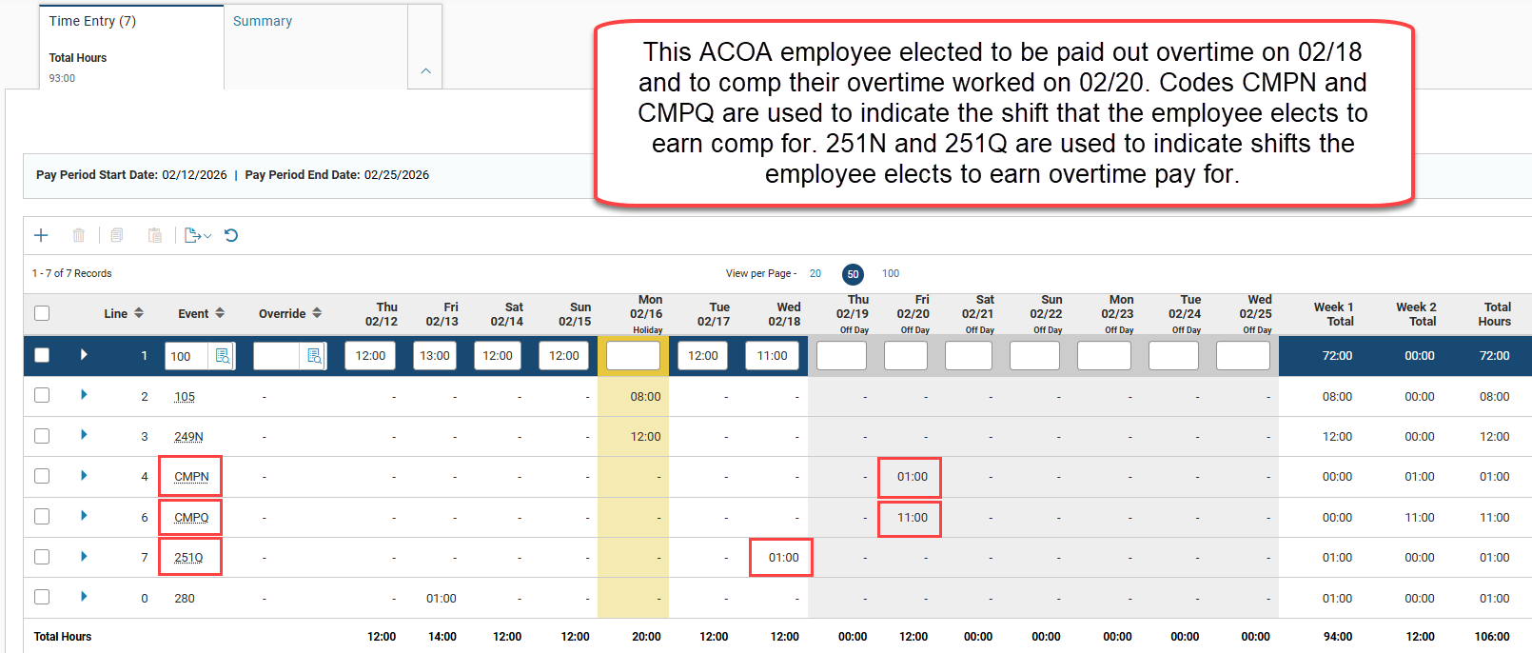
Example 4- ACOA/Daily Comp Time

